Slide 1
Privacy Preservation in the Android Ecosystem
PhD Oral Examination
Mark Huasong MENG
National University of Singapore
Supervisor
Professor Dong Jin Song
Chair
Associate Professor Roland Yap Hock Chuan
Examiners
Associate Professor Chang Ee Chien
Associate Professor Liang Zhenkai
Notes:
Good morning, dear examination panel, chair, and guest, ladies and gentlemen. Welcome to my thesis defense seminar.
The title of my today’s seminar is…

Slide 2

Android Ecosystem
People heavily rely on their personal mobile devices in their daily lives.
In the year 2023 alone, a total of 1.23 billion units of smartphones were purchased by end users*.
76% of newly activated devices are installed with Android OS⁺.
* https://www.statista.com/topics/840/smartphones
+ https://www.idc.com/promo/smartphone-market-share
Notes:
First of all, let me quickly introduce some backgrounds.
Nowadays, people are heavily relying on their personal mobile devices in their daily lives.
Just for the last year, there was a total of 1.23 billion units of smartphones purchased by end users.
And among these 1.23 billion smartphones, 76% are installed with Google’s Android OS, which are also known as “Android devices”.

Slide 3

Android Ecosystem
The Android ecosystem is well-known for the great number of third-party applications (apps).
Our personal data are pervasively accessed and utilized by apps in the name of data analytics and personalized advertising.
Notes:
The Android ecosystem is well-known for the great number of third-party applications which greatly enriches our life, increasing our productivity.
However, this convenience comes with the cost of our personal data, ranging from the diverse device identifiers to the users’ physical location, being pervasively accessed and utilized in the name of data analytics and personalized advertising purposes.

Slide 4
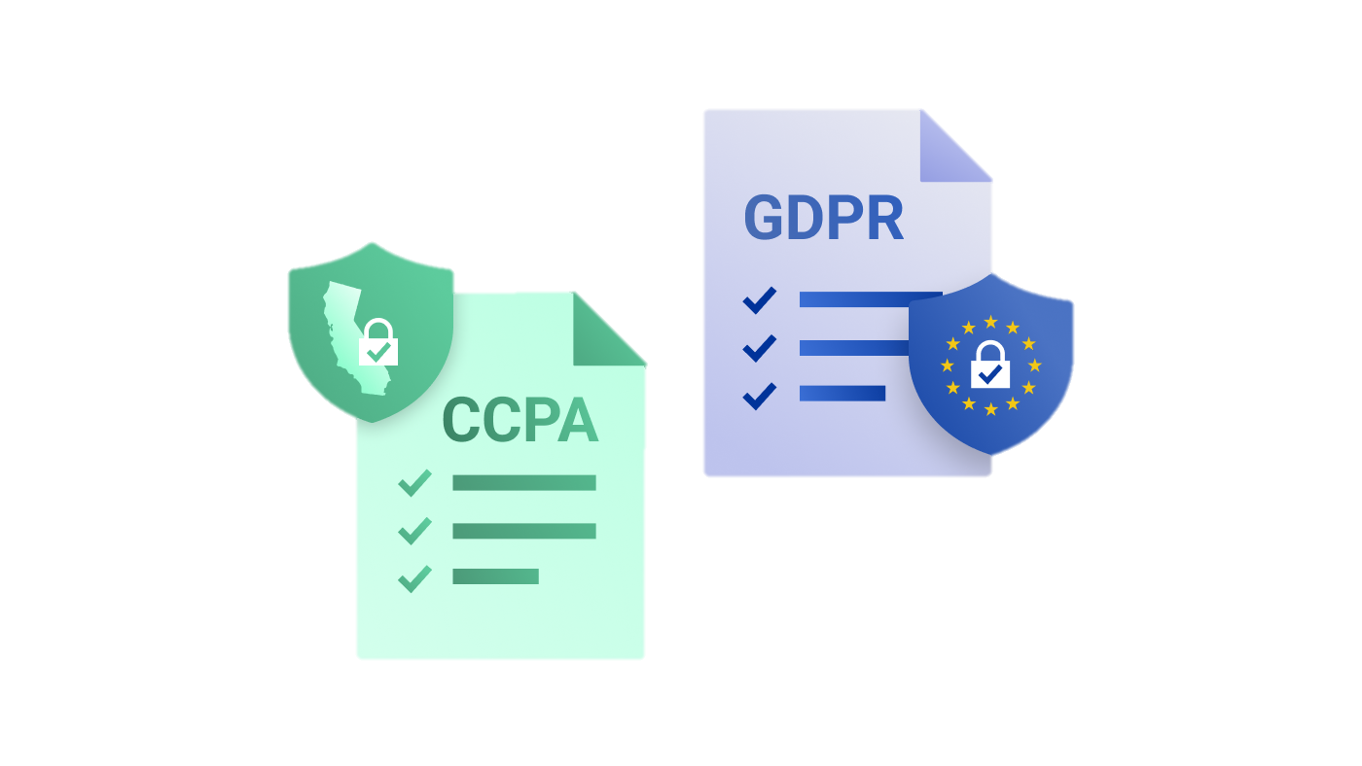
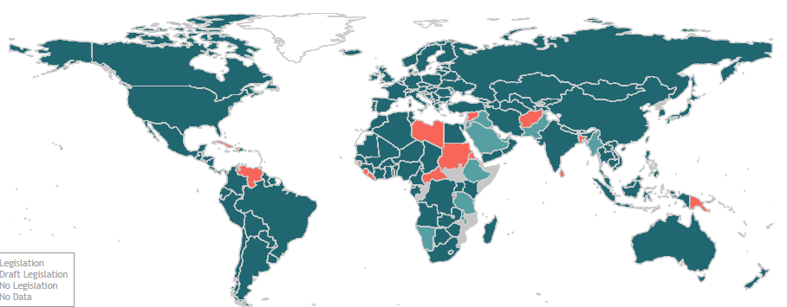
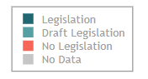
Post-GDPR Era
The protection of personal data has gained a great deal of attention around the world.
137 out of 194 countries had put in place legislation to secure the protection of data and privacy.
EU’s General Data Protection Regulation (GDPR)
California Consumer Privacy Act (CCPA)
Our phones are the first line of defence against privacy infringement.
Data Protection and Privacy Legislation Worldwide (as of 2022)
Notes:
On the other hand, the protection of personal data has gained a great deal of attention around the world.
As of 2022, there are 137 out of 194 countries have put in place legislation to secure personal data and privacy protection.
The European Union’s GDPR is one of the most representative laws which is known to stipulate a large penalty if a company is found not properly handling users’ personal data.
And our smart phones, as our daily used devices, are becoming the first line of defense against privacy infringement.

Slide 5
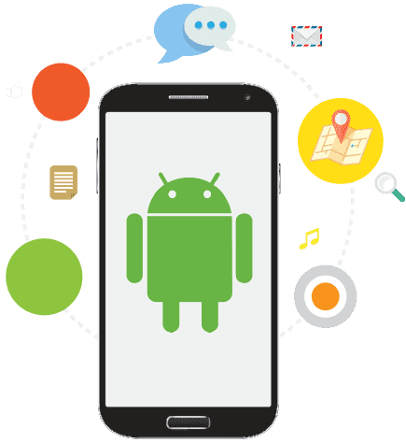

Personal Data Access
The collection of personal data follows a simple routine: an app requests access to personal data, and the operating system serves the personal data.
Personal data request of an app is not necessarily initiated by app developer’s implementation.
The embedding SDKs and ML components may also collect personal data.
Request
App developer’s implementation (core functionality)
SDKs
ML components
Serve
An app
Notes:
Talking about personal data access, we assume the collection of personal data should all follow a simple routine: ... [READ]

Slide 6


Privacy Preservation in the Android Ecosystem
Personal data exfiltration in third-party apps has been extensively studied since the nascent stage of Android history.
App analysis only offers a partial view of the data exfiltration in the entire Android ecosystem.
There are still some open questions to complement existing research and unveil the complete landscape of privacy preservation.
Whether SDKs strictly comply with privacy policies?
Whether OS well protects user privacy?
Whether ML on mobile devices can be privacy-preserving?
Notes:
Now let’s move back to the Android ecosystem, we learned that the personal data exfiltration in third-party apps has been extensively studied since the nascent stage of Android history.
Another good news as a relief, is that Google has deployed strict and comprehensive regulation over third-party developers to ensure their apps to comply with privacy and personal data protection laws globally.
However, all these efforts, only offer a partial view of the data exfiltration in the entire Android ecosystem.

Slide 7


Roadmap
Third-party apps are just one role in the entire Android ecosystem → How about the operating system itself? (1st work)
Not all code is written by app developers → Third-party libraries/SDKs are widely used in apps! What is the landscape of their compliance? (2nd work)
The prevalence of data-hungry machine learning applications → How to minimize data sharing in collaborative machine learning scenarios? (3rd work)
Operating System (OS)
Third-party
SDKs
Machine Learning
The OS is supposed to well preserve user privacy against arbitrary access and sharing
Privacy preservation of SDK should align with the privacy practice of the host app
Collaborative ML on mobile devices should minimize the exposure of user’s data
Notes:
To unveil the complete landscape, there are three questions waiting to be addressed. [READ]

Slide 8
Thesis Organization
This thesis is composed of three research works:
Dissecting whether the operating systems (OSes) themselves comprehensively safeguard users’ personal data;
Investigating the third-party SDKs’ privacy preservation and their compliance
Designing a practical data-free optimization approach toward privacy-preserving Byzantine-resilient federated learning
Notes:
What I have done reflected in this thesis, is composed of three research works, which I will present in the later slides. [READ]

Slide 9
OS-level Safeguards of User-unresettable Identifiers (UUIs)
The 1st Work
This work has been accepted and presented in NDSS 2023:
M. H. Meng, Q. Zhang, G. Xia, Y. Zheng, Y. Zhang, G. Bai, Z. Liu, S. G. Teo, J. S. Dong, “Post-GDPR Threat Hunting on Android Phones: Dissecting OS-level Safeguards of User-unresettable Identifiers”, The Network and Distributed System Security Symposium (NDSS), San Diego, USA, 2023.

Slide 10
Background
Google has taken steps to enforce new privacy features to restrict apps’ use of user data.
Representative privacy changes in Android 10:
New privileged permissions
READ_PRIVILEGED_PHONE_STATE
Only granted to privileged system apps.
App-unique and user-resettable identifiers
Android advertising ID
Compulsory disclosure of apps’ access, collection, use, and sharing of user data.
Notes:
As mentioned earlier, after the introduction of GDPR, Google has taken steps to enforce new privacy features to restrict apps’ use of personal data, especially on user unresettable identifiers.
Let’s take Android 10.0 as an example. There are 3 major changes, as shown on the slide.
The first change is the introduction of a new privileged permission, READ PRIVILEGED PHONE STATE, which is only granted to privileged system apps.
Second, a new app-unique and user-resettable identifier called Advertising ID is introduced to replace the existing Android ID.
Third, app developers are requested to properly disclose their access, collection, use, and sharing of user data to comply with the newly introduced GDPR.

Slide 11
Related Work & Motivation
Personally identifiable data exfiltration in Android at app-level or library-level has been extensively studied by the research community (Enck et al., 2014, Qiu et al., 2015, Ren et al., 2018, Wang et al., 2020).
Privacy protection at OS-level is still an open question.
Many types of personally identifiable data served at OS-level are user-unresettable.
Serial number, IMEI, MAC Address, etc.
Not easily replaceable as a password once leaked.
We refer to them as user unresettable identifiers (UUIs).
Whether the operating systems (OSes) themselves comprehensively safeguard UUIs?
Notes:
Now moving research perspective. During the past decade, we have witnessed that the personally identifiable data exfiltration in Android at app-level or library-level has been extensively studied.
Leaving privacy protection at OS-level an open question.
In the meantime, we learn that many types of personally identifiable data served at OS-level are user-unresettable, for example the serial number, IMEI and MAC address.
They are not easily replaceable as a password once leaked, and therefore we refer to them as user unresettable identifiers, shortly written as UUIs.
So, we are curious about one question: whether the operating systems themselves comprehensively safeguard UUIs.
And we are going to investigate this question in this paper.

Slide 12
Understanding Android UUIs
These 6 pre-identified UUIs are useful for us to form our understanding of more types of undiscovered UUIs on Android devices.
# | UUI | Category | API(s) | Permission/API changes*
1 | Serial number | Chip & Cellular | android.os.Build: getSerial() | V8-9: READ_PHONE_STATE required. ≥10: READ_PRIVILEDGED_PHONE_STATE required.
2 | Device ID (IMEI or MEID) |  | android.telephony.TelephonyManager: getImei(), getDeviceId(), getMeid() | <10: READ_PHONE_STATE required. ≥10: READ_PRIVILEDGED_PHONE_STATE required.
 |  |  | android.telephony.TelephonyManager: getSimSerialNumber() android.telephony.SubscriptionInfo: getIccid()
3 | ICCID
 |  |  | android.telephony.TelephonyManager: getSubscribeId()
4 | IMSI
5 | Bluetooth MAC Address | Wireless Module | android.bluetooth.BluetoothAdapter: getAddress() | All versions: BLUETOOTH required. ≥10: Randomization or a fixed return value required. V6-10: ACCESS_COARSE_LOCATION or ACCESS_FINE_LOCATION required. ≥10: ACCESS_FINE_LOCATION becomes mandatory.
6 | WiFi MAC Address |  | android.net.wifi.WifiInfo: getMacAddress() | All versions: ACCESS_WIFI_STATE required. V6-9: Randomization suggested. ≥10: Randomization becomes mandatory.
For each UUI, there is/used to be at least 1 official API for apps to access.
* The color scheme indicate the permission protection levels: normal, dangerous, and signature.
Notes:
First of all, we need to form a comprehensive understanding of Andriod UUIs.
This slide shows the 6 pre-identified UUIs, as you may say that they are very common, exactly you’re right.
[CLICK]
These 6 UUIs are officially documented by Google, and they all have official APIs for apps to access.
For each UUI, there is at least 1 official API for apps to access.
[CLICK]
But in this paper, we are not only investigating whether these 6 UUIs are well protected or not.
We take these 6 UUIs as seeds, to explore how a UUI could be accessed by apps, and furthermore, how many UUIs that we have never seen before, are in risk of privacy leakage.

Slide 13
Goal & Challenges
We design and implement U2-I2 (short for UUI Investigator)
Systematically investigates the OS-level UUI protection at large scale.
Designed to assess the protection of not only the six known UUIs, but also other previously unreported ones.
Challenges of our study:
Identify undocumented access channels
Automate assessment process
Pinpoint customized (undiscovered) UUIs
Notes:
Based on the 6 pre-identified UUIs, we are going to design and implement U2I2, to systematically investigate the OS-level UUI protection at large scale.
It is designed to assess the protection of not only the 6 pre-identified UUIs, but also other previously unreported ones.
To achieve our goal, we summarize the main challenges of our study into three points.
First of all, we aim to identify undocumented access channels other than the Android official APIs.
On this basis, we would like to make this process automated as much as possible.
Last but not least, after identifying undocumented access channels, we would like pinpoint customized UUIs.

Slide 14
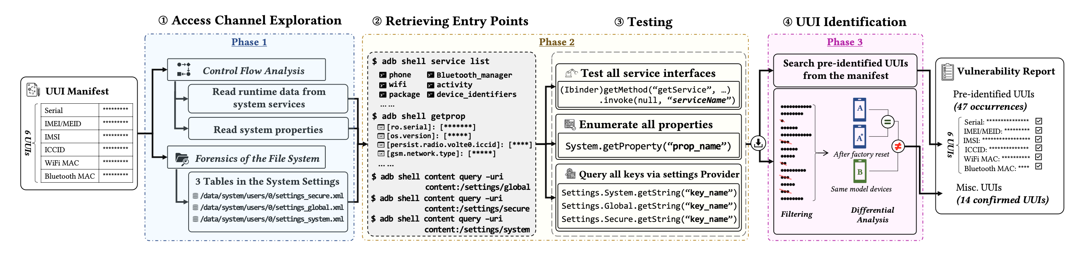
Approach Overview
U2I2 adopts a three-phase approach to assess undocumented channels.
Notes:
Because we have already recognized 6 pre-identified UUIs, our approach starts with documented channel assessment.
At this step, U2I2 tests the UUI access on behalf of a third-party application.
We aim to test 2 types of errors, namely legacy permissions and missing de-identification, for example the MAC address randomization in Android.

Slide 15
Assessing Undocumented Channels
Phase 1 - Access Channel Exploration
U2-I2 takes six pre-identified UUIs as seeds, considering that other unknown UUIs may share the same set of access channels.
Two strategies to explore undocumented channels:
Static control flow analysis
Extract method-level call relations until service managers
Map local interfaces to the corresponding remote interfaces
Pinpoint the components that serve the request
Filesystem forensics
Search the values of six pre-identified UUIs
Notes:
Next, I’ll share our assessment of undocumented channels. It begins with an exploration of undocumented access channels.
We take the 6 pre-identified UUIs as seeds and expect the unknown UUIs may share the same set of access channels.
To this end, we adopt 2 strategies.
The first one is static control flow analysis. We apply a 3 step approach to perform the static analysis.
We first of all extract method-level call relations until service managers.
After that, we map local interfaces to the corresponding remote interfaces, which are usually owned by Android system services.
In the end, we perform another round of static analysis to pinpoint the components that serve the UUI request.
Besides the static analysis, we also resort to filesystem forensics, to see if we can find any more access channels from there.

Slide 16
Assessing Undocumented Channels
Phase 1 - Access Channel Exploration
Through the exploration, U2-I2 recognizes three undocumented access channels:
System settings
Stored in persistent storage
Three key-value databases (.xml format)
System properties
Stored inside system directory
Indexed by keys
Initialized at boot time
System services
Enabled by inter-process communication
Serve API requests through its public interfaces
Notes:
So in the end, we manage to recognize 3 undocumented access channels, namely system settings, system properties and system services.

Slide 17





Assessing Undocumented Channels
Phase 2 – Retrieving Entry Points and Testing
U2-I2 makes use of public interfaces to query system properties and system settings, and resorts to a “hacking way” through Java reflection to bypass the permission check to invoke system services.
$ adb shell service list
Test all service interfaces
phone
wifi
package
… …
Bluetooth_manager
activity
device_identifiers
(Ibinder)getMethod(“getService”, …)
.invoke(null, “serviceName”)
$ adb shell getprop
Enumerate all properties
[ro.serial]: [*******]
[os.version]: [*****]
[persist.radio.volte0.iccid]: [****]
[gsm.network.type]: [*****]
… …
System.getProperty(“prop_name”)
Query all keys via settings Provider
$ adb shell content query –uri content:/settings/global
Settings.System.getString(“key_name”)
Settings.Global.getString(“key_name”)
Settings.Secure.getString(“key_name”)
$ adb shell content query –uri content:/settings/secure
$ adb shell content query –uri content:/settings/system
Notes:
After the access channel exploration, we move to the next step, retrieving entry points and testing.
To do this, U2I2 first retrieves entry points through the three undocumented channels, then tests through an app installed on the devices.
For the system properties and system settings, their testing is pretty easy because Google does provide public interfaces for apps to make the query.
But for the system services, conventional binding mechanism is not applicable for us because our tester app won’t have permission to bind all those system services. Therefore we resort to a hacking way through Java reflection to bypass the permission check to directly invoke the public interfaces defined in system services.

Slide 18


Assessing Undocumented Channels
Phase 3 – UUI Identification
Here we assume all UUIs have fixed entry names that can not be changed once created.
U2-I2 adopts a two-step approach to pinpoint unknown or OEM-defined UUIs
Filtering
Excludes values of insufficient size (e.g., 4 hex-digit)
Differential Analysis
Excludes values that are same across devices
Excludes values that are changed after factory reset
***********
********
*
******
***********
***
******
*****
**
*********
***
*****
***
********
A
=
*
A
≠
UUIs
After factory reset
B
Same model devices
Filtering
Differential Analysis
Notes:
After the testing, we will receive huge amount of data. So our next step is to identify UUIs from the data received.
Our U2I2 adopts a two-step approach to pinpoint unknown or OEM-defined UUIs. We first perform a filtering, to exclude values of insufficient size. Next we perform a differential analysis to exclude values that are same across devices, and value that are changed after factory reset.
By doing this, we can easily find UUIs from the data left to us.

Slide 19
Evaluation
Our evaluation aims to address three research questions:
RQ1: What is U2-I2’s performance in identifying UUI mis-handling issues? What is the status quo of UUI protection in the latest Android phones? Do their OSes comply with the up-to-date privacy policy of AOSP?
RQ2: Based on U2-I2’s findings, what UUIs are potentially exposed to non-system apps, and what are the typical exfiltration (exposure) points?
RQ3: Have our identified access channels of UUI access already been (ab)used by apps in the wild?
Notes:
Before we moving to the details of the evaluation part, please let me to brief our target.
Primarily, our evaluation aims to address 3 research questions: [READ]

Slide 20
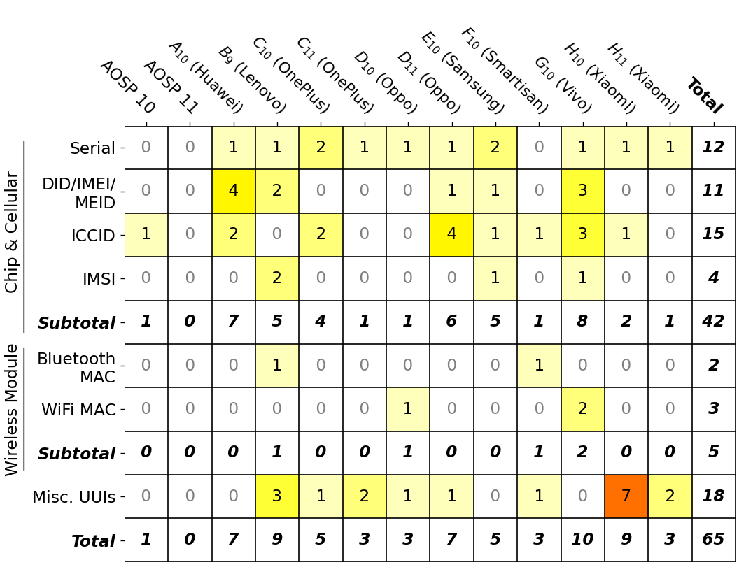
Key Finding for RQ1
Landscape of OS-level UUI Safeguards
Test devices cover 13 latest models from 9 manufacturers, which represent almost 85% of the global market share of Android devices*.
The UUI mishandling issues are pervasive in the latest Android phones.
51 unique vulnerabilities, leading to 65 occurrences of UUI leakages.
12 out of 13 tested device models contain at least 1 UUI leakage,
1 vulnerability found in AOSP# and is inherited in all tested OEM devices.
18 leakages are associated with unknown UUIs (classified as misc. UUIs)
Statistics of the occurrence of UUI leakages detected in our assessment, counted by UUI types and devices
* Data source https://gs.statcounter.com/vendor-market-share/mobile/worldwide
# Google Pixel model(s). AOSP 11 stands for a Google Pixel phone installed with Android OS 11.
Notes:
Our first key finding, which address the RQ1, is the landscape of OS-level UUI safeguards.
We conduct a large scale device testing that covers 13 latest models from 9 manufacturers, which represent almost 85% of the global market share of Android devices.
And we find the UUI mishandling issues are pervasive in the latest Android phones.
[READ THE SLIDE]

Slide 21
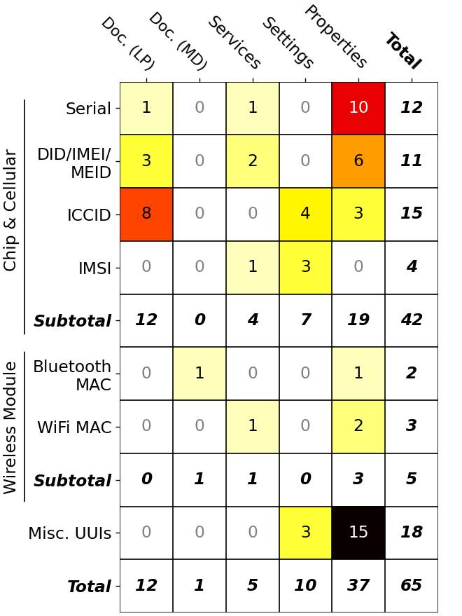
Key Finding for RQ2
Exfiltration points via undocumented access channels
The undocumented access channels are the major exfiltration points.
Contributes 45 out of all 51 vulnerabilities
5 are caught from the system services, 10 in system settings, and the remaining 30 from system properties.
Statistics of the occurrence of UUI leakages detected in our assessment, counted by UUI types and access channels
Notes:
For the RQ2, we analyse the exfiltration points that U2I2 managed to identify.
We find that … [READ]

Slide 22
Key Finding for RQ3
Exploits in the wild
“
Have our identified undocumented channels already been (ab)used in the wild?
We test the top 150 apps from the Google Play Store and another 150 apps from an alternative app store (Xiaomi App Store).
12 out of 300 analyzed apps have relevant behaviors.
All their accesses are through undocumented access channels.
The broad UUI collection by apps in the wild is not observed in our study.
List of apps found potential UUI collection
# | App package name | Downloads (by Dec 2021) | Involved UUIs | Access channels
1 | com.kwai.m2u | 81mil+ | Device ID, Misc. UUI⁺ | Properties
2 | com.kwai.videoeditor | 86mil+ | Device ID, Misc. UUI⁺ | Properties
3 | com.lbe.parallel.intl | 100mil+ | IMSI | Services
4 | com.liulishuo.engzo | 116mil+ | Device ID | Properties
5 | com.oppo.store | 3mil+ | Misc. UUI⁺ | Properties
6 | com.renrendai.haohuan | 25mil+ | Device ID | Properties
7 | com.tencent.qqimsecure | 682mil+ | IMSI | Settings
8 | com.tencent.wifimanager | 192mil+ | IMSI | Settings
9 | com.wuba.zhuanzhuan | 234mil+ | Device ID | Properties
10 | com.xunmeng.merchant | 50mil+ | Serial | Properties
11 | com.xunmeng.pinduoduo | 5bil+ | Serial | Properties
12 | ru.yandex.searchplugin | 100mil+ | Device ID | Properties
+ The caught UUI access is through requesting the system property “gsm.serial”.
Notes:
Our last key finding, aim to answer the question that, have our identified access channels of UUI access already been abused by apps in the wild.
[JUST READ]

Slide 23
Responsible Disclosure & Impact
We have reported all our findings to the relevant parties/stakeholders.
We have received 8 CVE entries registered by Google and four other manufacturers.
CVE-listed vulnerabilities found by U2-I2
# | CVE ID | Affected devices | Involved UUIs
1 | CVE-2020-12488 | Vivo | Serial
2 | CVE-2020-14103 | Xiaomi | Serial
3 | CVE-2020-14105 | Xiaomi | Misc. UUI (ro.ril.oem.sno)
4 | CVE-2021-0428 | Pixel | ICCID
5 | CVE-2021-25344 | Samsung | Serial
6 | CVE-2021-25358 | Samsung | IMSI
7 | CVE-2021-26278 | Vivo | WiFi MAC address
8 | CVE-2021-37055 | Huawei | ICCID
Notes:
We would also remark our responsible disclose. [READ]

Slide 24
Contributions
The first comprehensive study to understand OS-level UUI protection.
A systematic assessment approach to explore undocumented channels.
Revealing the status quo of UUI protection on the latest versions of Android.
Notes:
Okay, its time to wrap up.
This paper has three main contributions.
First, we conduct the 1st comprehensive study to understand OS-level UUI protection in Post-GDPR era.
We also designed a systematic assessment approach, that is capable to explore as many undocumented channels as possible.
Finally, we successfully reveal the landscape of UUI protection on latest versions of Android OS.

Slide 25
A Large-Scale Privacy Measurement at the Third-Party SDK Level
The 2nd Work
This work has been submitted and is under peer review.
M. H. Meng, C. Yan, Y. Hao, Q. Zhang, Z. Wang, K. Wang, S. G. Teo, G. Bai, J. S. Dong, “A Large-Scale Privacy Measurement of Android Third-Party SDKs”, Preprint.
Notes:
Now let’s move to our second study, privacy preservation at the third-party SDK level.

Slide 26
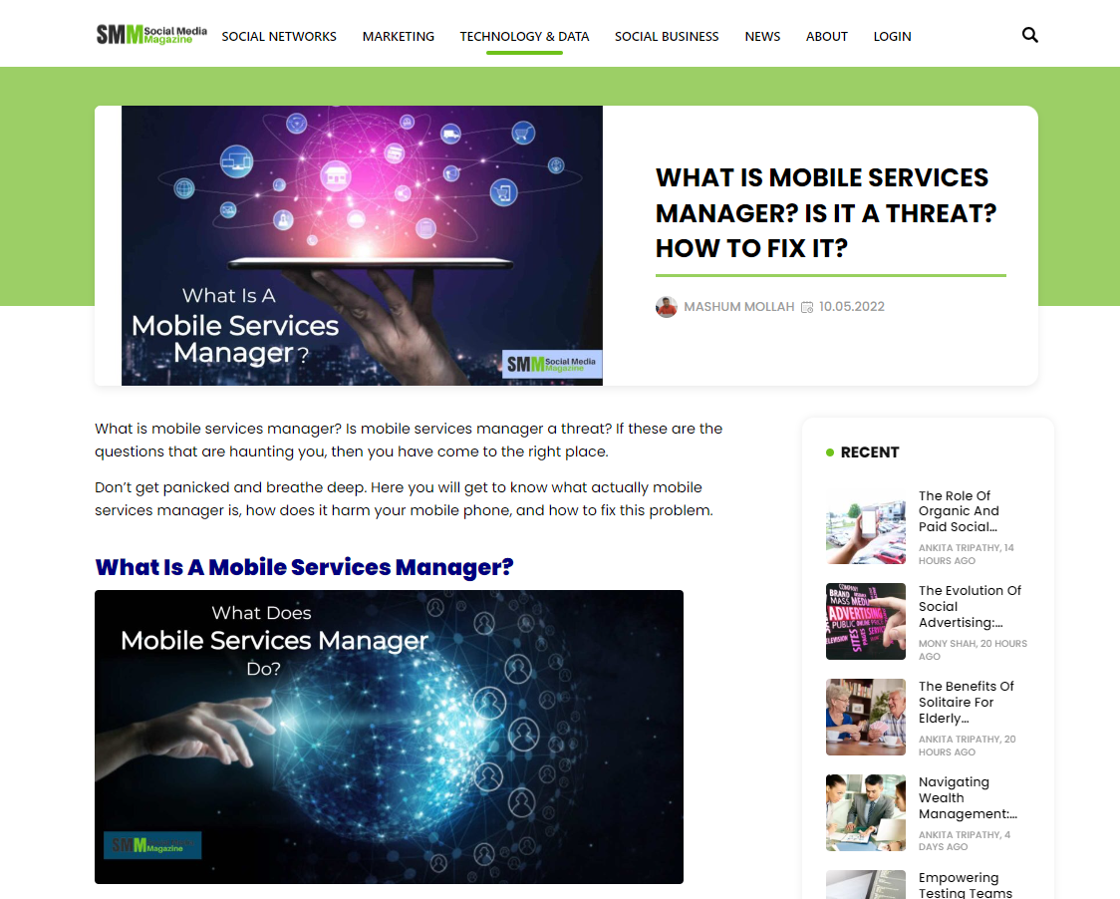

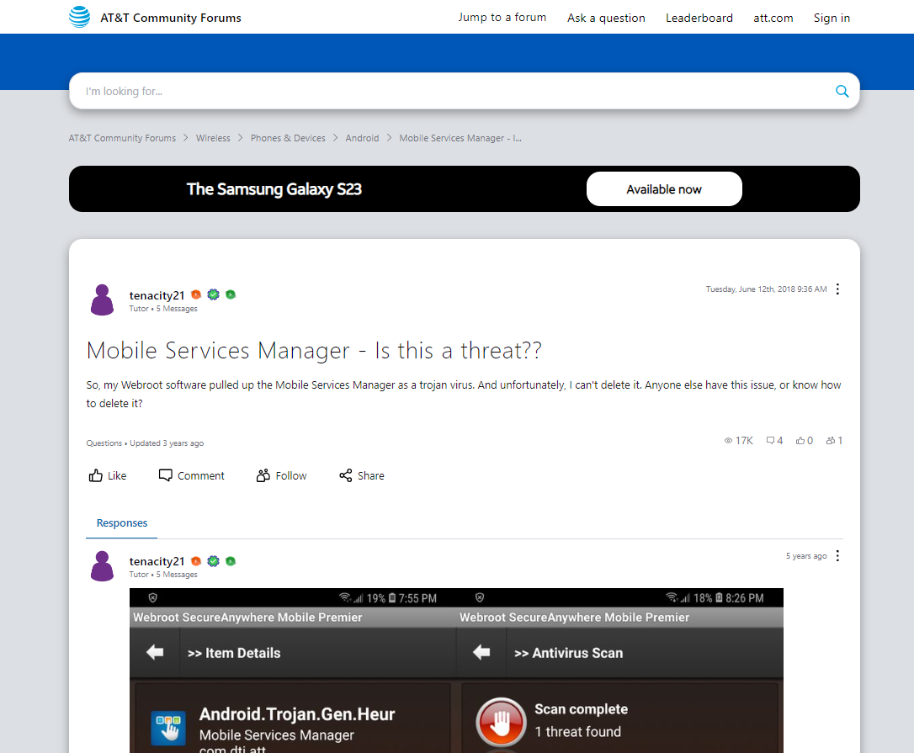
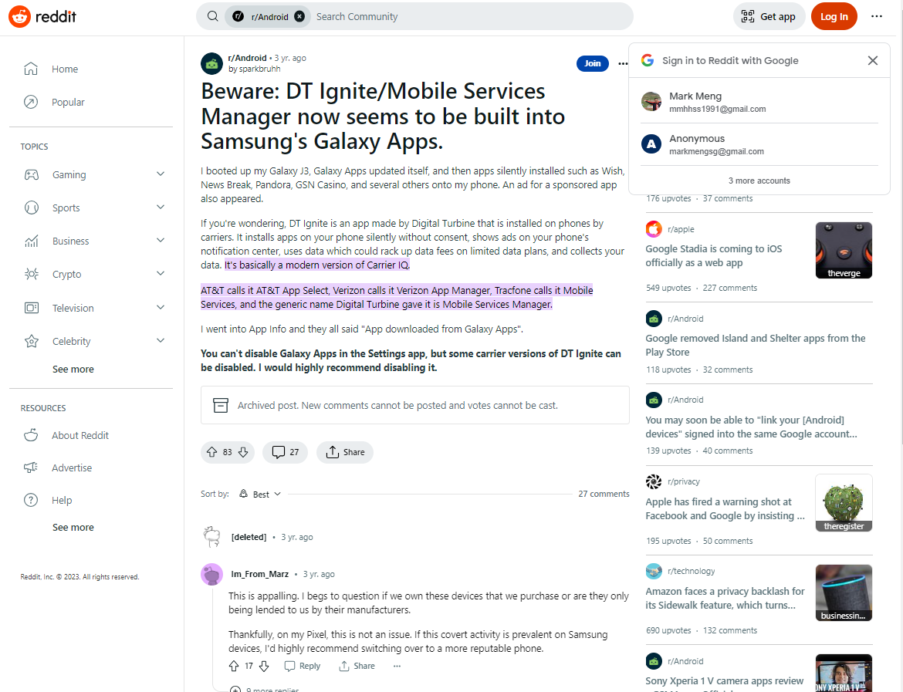
Background
A Motivating Example – Mobile Services Manager
A well-known rogue SDK that downloads apps without user’s consent and spams notifications without user’s permission.
Embedded in a pre-installed carrier’s app in the same name or named “DT Ignite”.
Widely covered by media.
What is Mobile Services Manager? Is it a threat? How to fix it?
What is Mobile Services Manager and how to disable it?
Mobile Services Manager – is this a threat?
Beware: DT Ignite/Mobile Services Manager now seems to be built into Samsung’s Galaxy Apps
Notes:
This slides demonstrate a real-world example, to prove that our concern is true.
There is a well-known SDK named mobile services manager, which download apps … [READ]
This news, has been widely covered by media, raising an alert to our research community to pay attention to third-party SDKs.

Slide 27
Background
Privacy Protection in SDKs
Lack of Transparency
Implementation of third-party SDKs is black-box to app developers
Hard to manage personal data access when there is a permission requested and granted by the embedding app
Insufficient Regulations
Markets do not impose a strict regulation (like apps)
Privacy policies are often composed of vague and ambiguous guidelines
SDK users (developers of the embedding apps) are often left in the darkness.
Notes:
The Android SDKs gain our attention because of two main reasons.
First of all, the development of third-party SDK does not come with adequate transparency.
[READ]
Second, there is insufficient regulations in the market.
[READ]

Slide 28
Related Work
Third-Party SDKs Privacy Leakage Analysis
There is a substantial body of literature addressing various aspects of privacy concerns in the Android ecosystem, which mainly focusing on the privacy preservation OS level [Meng et al., 2023] and app level [Enck et al., 2010, Zhang et al., 2009, Zhou et al., 2013].
Various analysis techniques have been explored, including dynamic analysis [He et al., 2018, Razaghpanah et al., 2018] and static analysis [Enck et al., 2010, Meng et al., 2023].
Privacy protection of third-party libraries has been explored in [He et al., 2018, Liu et al., 2020] although there lacks a study in large scale.
Privacy Compliance Evaluation in Other Fields
Numerous works focus on detecting inconsistencies between the privacy practices of an app and its descriptions/privacy polices [Andow et al., 2020, Yu et al., 2021].
Recent literature [Yan et al., 2024] resorts to large language models to assess of privacy-related documents that varies in length, structure, and writing quality.
There is no large-scale privacy measurement in the Android ecosystem at the SDK level.
Notes:
This slides provide some relevant literature that inspires us to initialize this study.
Mostly, we refer to the existing research in two fields. One is third-party SDKs privacy leakage analysis. [READ]
The other filed that we are interested in, is privacy compliance evaluation. [READ]

Slide 29
Goal & Challenges
This work aims to gain insights into the landscape of privacy protection at the SDK level through a large-scale study of existing SDK packages.
Three Challenges
Assess SDK privacy disclosure in natural language
Investigate SDK privacy behaviors (read, collect, and share)
Measure SDK privacy preservation on a large scale
Notes:
Now back to my thesis. In this work, we aim to … [READ]

Slide 30
Potential Compliance Issues
Three types of issues are investigated:
(Type I) Privacy leakage
An SDK shares users’ privacy in public spaces.
(Type II) Excessive collection
An SDK attempts to read more types of privacy data than what it requests/claims in its privacy policy
(Type III) Over-claiming
An SDK is found to claim its access to more types of data than what it reads
Notes:
Now back to my thesis. In this work, we aim to … [READ]

Slide 31
Scope of Privacy Data
We resort to the privacy-related changes in each Android OS release and existing literature [Enck et al., 2010, Zhou et al., 2013, Meng et al., 2023, etc.] to complement the list of privacy data (e.g., user-unresettable identifiers (UUIs)).
41 types of privacy data categorized into 5 classes are recognized
Class 1: Chip, Cellular and Peripheral (e.g., IMEI, serial, telephone number)
Class 2: Wireless Communication (e.g., Bluetooth MAC, SSID/BSSID, IP address)
Class 3: Location and Sensors (e.g., camera, fine and coarse locations)
Class 4: Media and Software Specific Data (e.g., app list, media location, GAID)
Class 5: Personal Data (e.g., account info, contact list, browser bookmarks)
Notes:
In this study, we aim to identify as many types of user privacy as possible.
To better understand the scope of user privacy, we do not only take conventional privacy data into considerate, for example, users’ contact, photo, and calendar.
We also resort to the privacy-related changes in each … [READ]

Slide 32
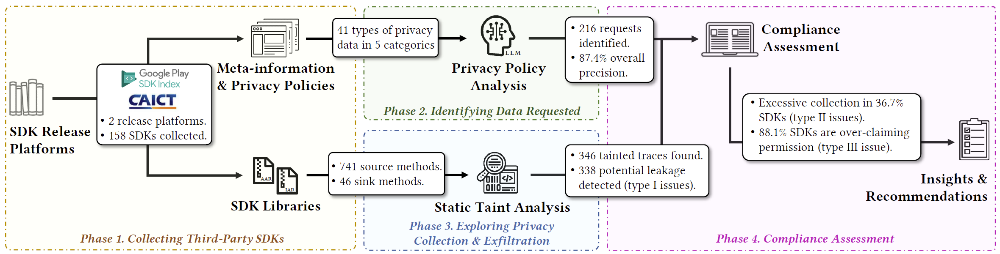
Our Approach
An overview
A large-scale study to analyze what do SDKs collect and what do SDKs claim to collect.
What does an SDK claim to collect?
What does an SDK (really) collect?
Notes:
To address those challenges, we performed a systematic analysis in large-scale, as shown on the screen.
Generally speaking, our approach is two-fold.
[CLICK FOR THE NEXT SLIDE]
We begin with collecting as many SDKs as possible from mainstream SDK release platform, to make this study in a large-scale.
After that, we perform two streams of analysis. First, we resort to the state-of-the-art large language models to help us understand and infer the privacy policies of SDKs, and then summarize what types of data that those SDKs claim to access.
For the second stream, we analyse the implementation of the collected SDKs. We resort to taint analysis to identify any program trace that attempts to read user privacy and consequentially shares it to the public. Our study also aims to explore if there exists any potential leakage of personal privacy.
In the end, we combine the findings of two streams’ analysis and eventually unveil the landscape of SDK-level privacy preservation, followed by sharing our insights and recommendations.

Slide 33
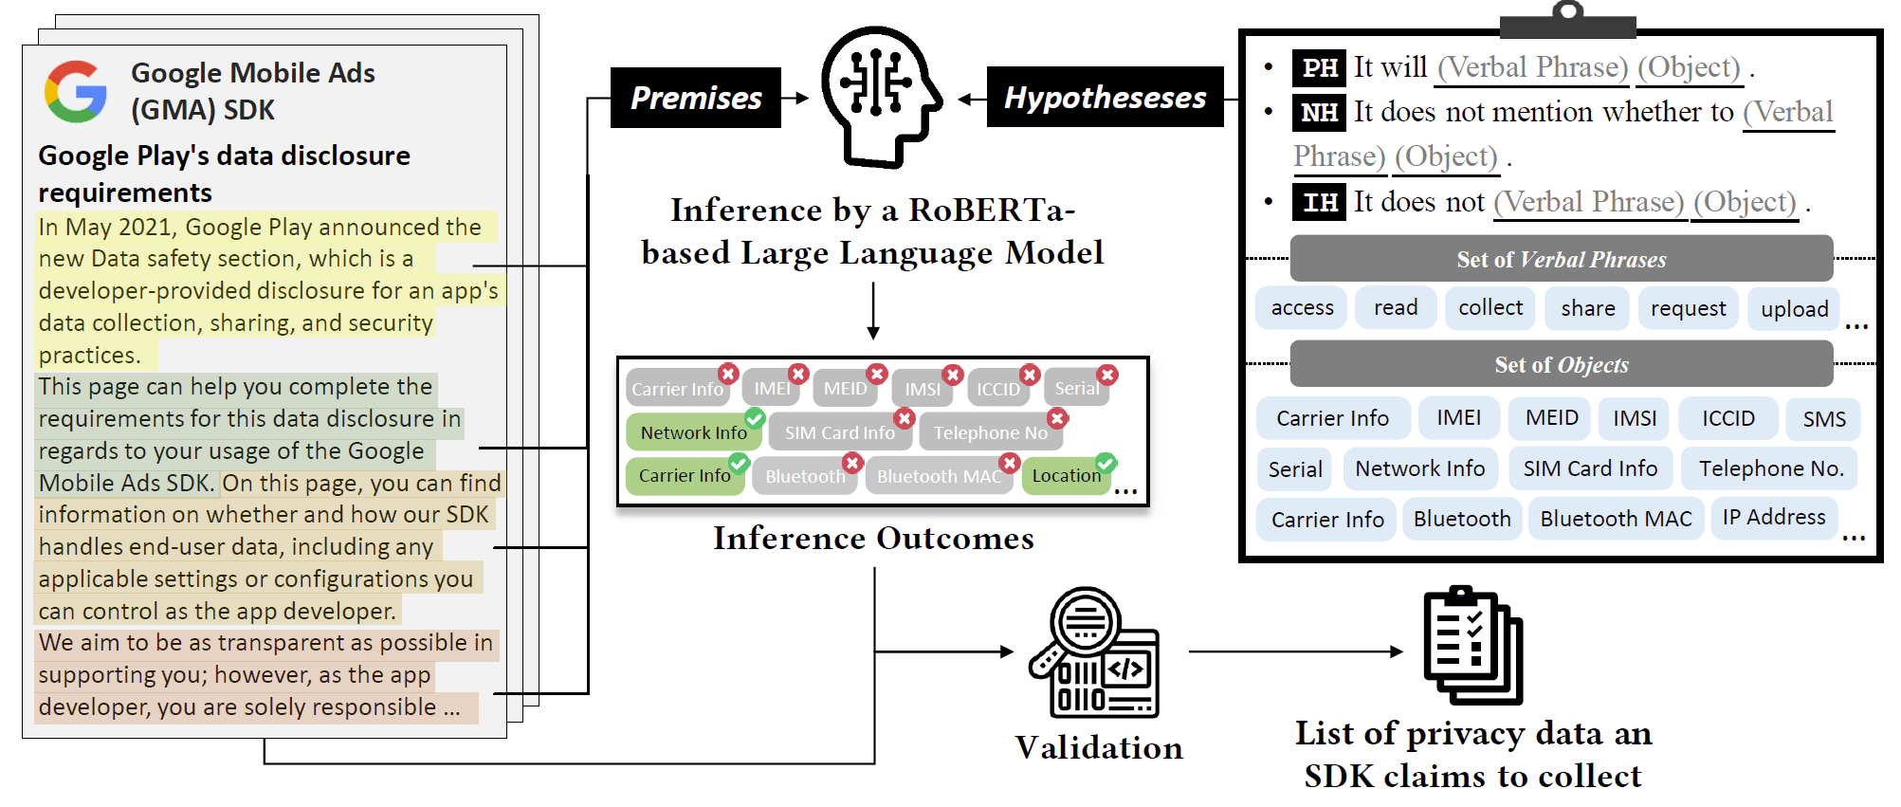
Identifying Data Requested in Privacy Policies (Phase 2)
Adoption of NLI model
We use a set of hypotheses to query the language model.
We resort to the state-of-the-art large language model to infer privacy data collection.
We take every sentence from the privacy policy to the language model as the Premise.
For each data type, we let LLM determine whether the hypothesis entails the premise.
* We adopt the model named roberta-large-snli_mnli_fever_anli_R1_R2_R3-nli
Notes:
Next, we resort to the latest large language models to help use understand the natural language in privacy policies.
The objective of this step is to extract which types of privacy data are claimed to be collected in the privacy policy documents.
To this end, we proposed an inference process.
For each SDK that provides a privacy policy, we take every sentence from the privacy policy to the language model as the Premise, and then we use a set of hypothesis to query the language model.
Specifically, as we have identified 41 data types of user privacy, we filled those 41 data types in a few template queries, and let the language model determine whether the hypothesis entails the premise or not.

Slide 34


Identifying Data Requested in Privacy Policies (Phase 2)
Inference of Data Requested
Each hypothesis set is composed of three hypotheses, i.e. positive hypothesis (PH), negative hypothesis (NH), and irrelevant hypothesis (IH).
Privacy policy
PH It will (Verbal Phrase) (Object) .
IH It does not mention whether to (Verbal Phrase) (Object).
NH It does not (Verbal Phrase) (Object) .
Score_{p}
Score_{i}
Score_{n}
“It will request MAC address.”
“It does not mention whether to request MAC address”
“It does not request MAC address”
$$({Score}_{p}>T)∧({Score}_{p}>{Score}_{i})∧({Score}_{p}>{Score}_{n})$$
* We adopt 0.73 as the optimal threshold (T) to achieve the minimal false negative rate.
Notes:
As shown on this slide, each hypotheses set is composed of three hypotheses, namely a postive hypothesis PH, a negative hypothesis NH, and an irrelevant hypothesis IH.
We determine if a data type is claimed to be collected by the examined SDK if the score of PH is greater than the threshold value and meanwhile, greater than the confidence socres of NH and IH.

Slide 35
Exploring Privacy Collection (Phase 3)
We resort to static taint analysis* to identify “What do SDKs collect?”
We recognize APIs that collect the previously identified privacy data as source methods and identify the APIs that could save or share those privacy data into public spaces as sink methods.
741 source methods are selected to cover the 41 identified privacy data
46 methods are identified as the sink methods, with their functionalities covering network transfer, file saving, and writing into the system settings. All the sinks are considered public locations that an arbitrary third-party app can access⁺.
* We resort to the latest open-sourced taint analysis toolkit for Android apps named “AppShark” to perform our analysis.
+ We remark that some access actions may need a non-dangerous permission (e.g., access Internet, read public directories, etc)
Notes:
As shown on this slide, each hypotheses set is composed of three hypotheses, namely a postive hypothesis PH, a negative hypothesis NH, and an irrelevant hypothesis IH.
We determine if a data type is claimed to be collected by the examined SDK if the score of PH is greater than the threshold value and meanwhile, greater than the confidence socres of NH and IH.

Slide 36
Evaluation
Our evaluation aims to address three research questions:
RQ1: Can our privacy policy analysis identify the privacy data claimed to be collected by SDKs in a large scale? What is the performance of our NLI model-based approach?
RQ2: Can our taint analysis find privacy data collection and sharing behaviors from the SDKs? How many tainted traces are detected? Can those tainted traces (really) leak users' privacy?
RQ3: By cross-checking their privacy disclosure, what is the status quo of personal data protection at SDK-level? Do the collected SDKs comply with their privacy policies?
Notes:
This slide summarize our evaluation for this work, so, three research questions as usual.
[READ THE SLIDE]

Slide 37
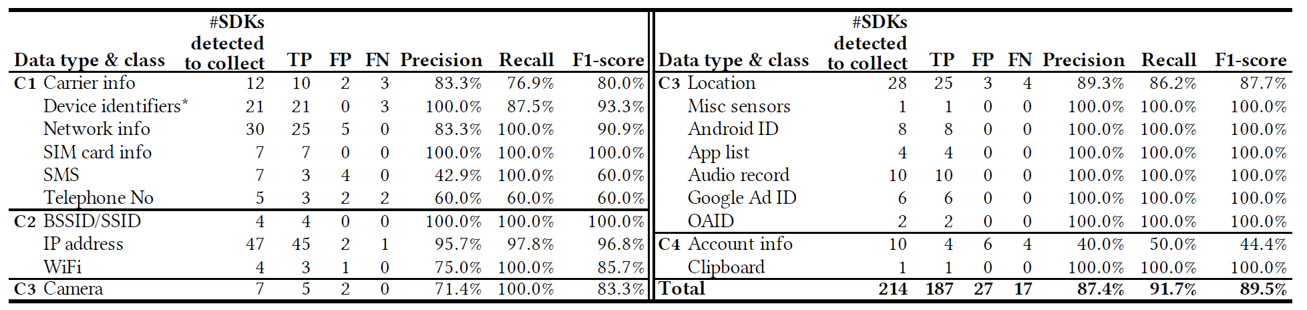
Evaluation
RQ1 Privacy Policy Analysis
Our analysis managed to identify 214 data requests from privacy policies.
The IP address (21.9%), network information (14.0%), and locations (13.0%) are the most requested privacy data.
Our NLI model achieves a promising precision of 87.4% and F1-score of 89.5%.
Notes:
So now, let’s go to the RQ1 first.
[READ]

Slide 38
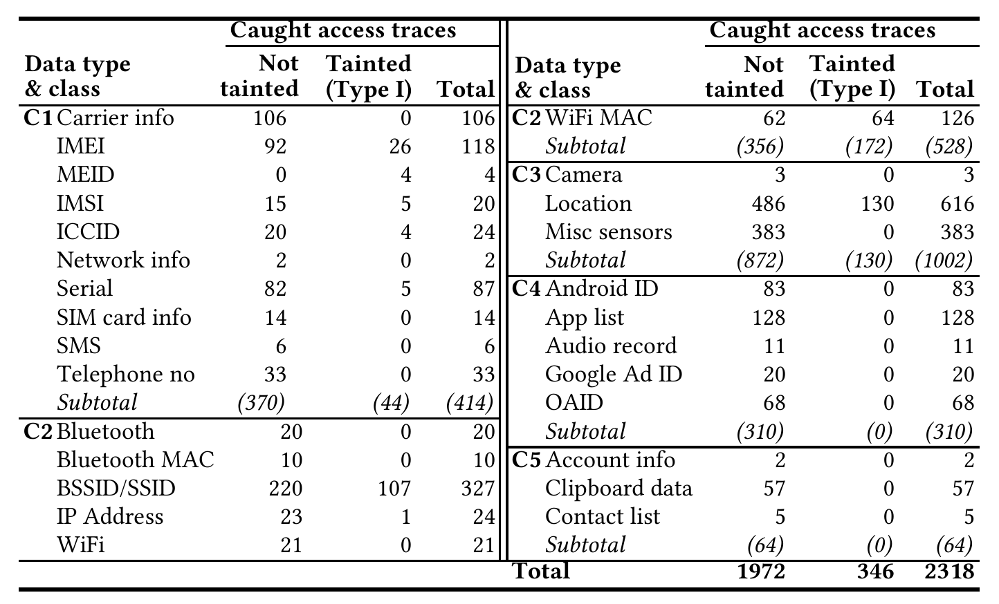
Evaluation
RQ2 Privacy Collection and Potential Leakages at SDK-Level packages
Through analyzing the 158 SDKs, we manage to identify 2,318 occurrences of privacy data collection in their implementation.
The location and sensor data (C3, 43.2%) are the most read privacy data type.
34 (21.5%) analyzed SDKs contain at least one trace tainted.
346 sharing actions were observed from the 158 SDKs.
The wireless communication data (C2, 49.7%) are the most shared privacy data type.
338 out of 346 (97.7%) tainted traces are logically valid traces (Type I issue).
Notes:
[READ]

Slide 39
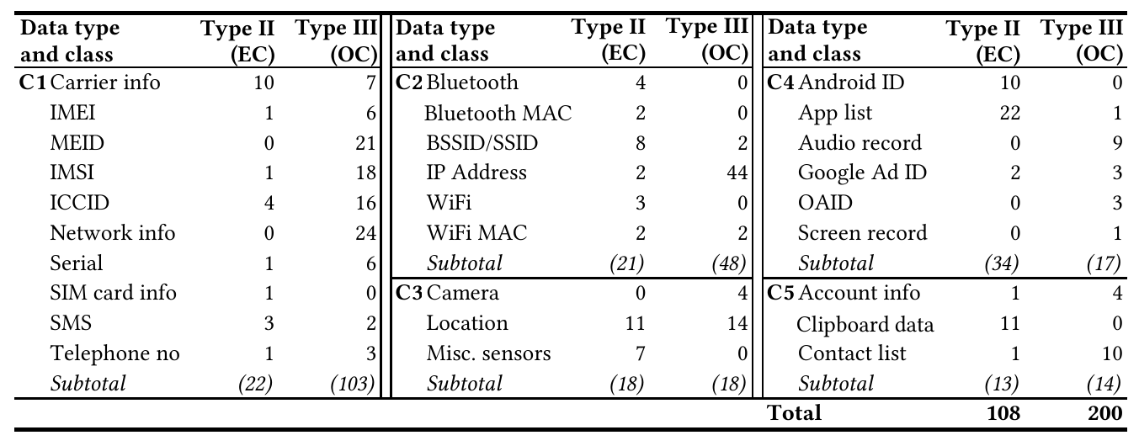
Evaluation
RQ3 SDK-Level Privacy Assessment
We resort to cross-checking the privacy policy with the caught data collection behaviors of the collected SDKs in their implementation.
Excessive collection of users’ privacy (36.6%) and over-claiming collected data types in privacy policies (88.1%) are prevailing issues.
App list, clipboard data, and location are the top 3 excessively collected data types .
IP address, IMEI, and Google Ad ID are the top 3 data types over-claimed by SDKs.
Notes:
Our last research question, is to analyse the overall compliance.
[READ]

Slide 40
System Settings Injection Issues
Findings and Impact Analysis
System settings injection issues can be exploited by malicious SDKs when it is embedded in a pre-installed app or system app.
Successful exploitation can bypass the privacy mechanism of Android OS and share a UUI in the public space.
Our reserve engineering identifies 4 exploits of system setting injection issues from 2 SDKs.
SDK Name | Entry Name | Description of the value
Alicloud Push | dxCRMxhQkdGePGnp | IMEI/MEID, serial, or Android ID, AES encrypted, base64 encoded
 | mqBRboGZkQPcAkyk | IMEI/MEID, serial, or Android ID, AES encrypted, base64 encoded
Baidu LBS | com.baidu.deviceid.v2 | App’s package name and Android ID, MD5 encrypted
 | com.baidu.uuid | App’s package name and serial or a random UUID, MD5 encrypted
The caught 2 SDKs have been found embedded in pre-install apps of devices from 9 OEM manufacturers, reserving over 94% Android smartphone market share in China.
Notes:
This slide shows the system settings injection issues we have discovered during our analysis, and the 4 exploits identified from the 158 SDKs.
[READ]
Here we highlight that ... (impact)

Slide 41
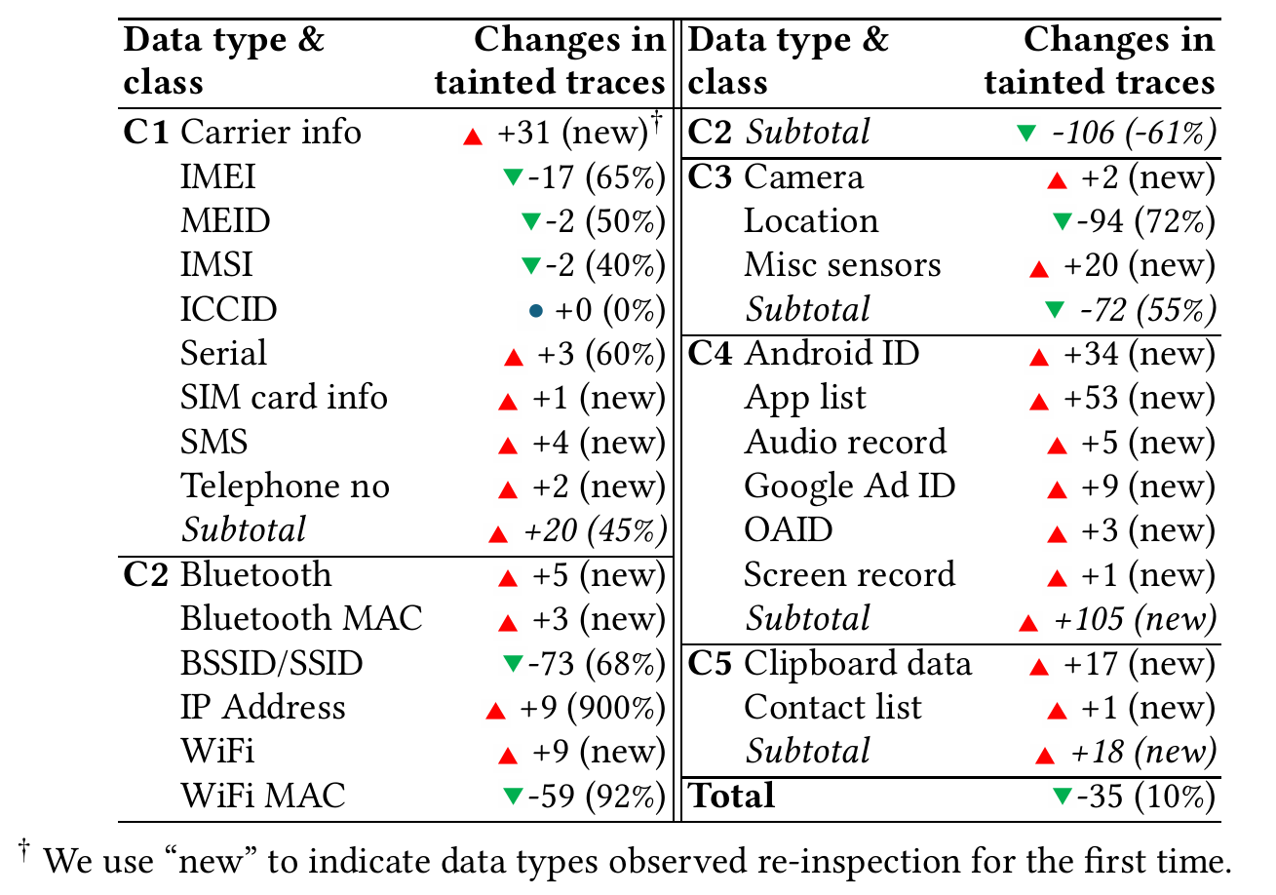
Privacy Compliance Re-Inspection
Based on our large-scale analysis of the 158 SDKs collected in October 2022, we re-visit the two sources (Google SDK Index and CAICT) and collect the same group of SDKs in their latest release version as of October 2023.
35 fewer traces that attempt to collect and share privacy data.
A drift of data collection pattern in data categories.
Our concern about excessive privacy collection has not eased amidst the evolution of SDKs.

Slide 42
Contributions
Detecting potential privacy leakage in a large-scale
Revelation of landscape of privacy protection at the SDK level
338 potential privacy leakages detected from 158 SDKs
Less than 70% of the examined SDKs provide privacy policies
Approximately 37% of SDKs are found indulging in the over-collection of privacy data, 88% of SDKs falsely claim their data request.
Amplified privacy risk caused by pre-installed privileged
Notes:
To wrap up, in this work, we achieved three contributions.
[READ]

Slide 43
Privacy-preserving Byzantine-resilient Federated Learning for Lightweight Devices
The 3rd Work
This work has been accepted and presented in PAKDD 2023 and ICECCS 2023:
M. H. Meng, S. G. Teo, G. Bai, K. Wang, and J. S. Dong, “Enhancing Federated Learning Robustness using Data-Agnostic Model Pruning”, Pacific-Asia Conference on Knowledge Discovery and Data Mining (PAKDD), Osaka, Tokyo, 2023.
M. H. Meng, G. Bai, S. G. Teo, J. S. Dong, “Supervised Robustness-preserving Data-free Neural Network Pruning”, The 27th International Conference on Engineering of Complex Computer Systems (ICECCS), Toulouse, France, 2023.
Publications relevant to this work also include:
M. H. Meng, G. Bai, S. G. Teo, Z. Hou, Y. Xiao, Y. Lin, J. S. Dong, “Adversarial Robustness of Deep Neural Networks: A Survey from a Formal Verification Perspective”, IEEE Transactions on Dependable and Secure Computing (TDSC), 2022.
Notes:
Ok, now we are arriving at the third study, which is also the last research of this thesis, Privacy-preserving Byzantine-resilient federated learning for lightweight devices.

Slide 44
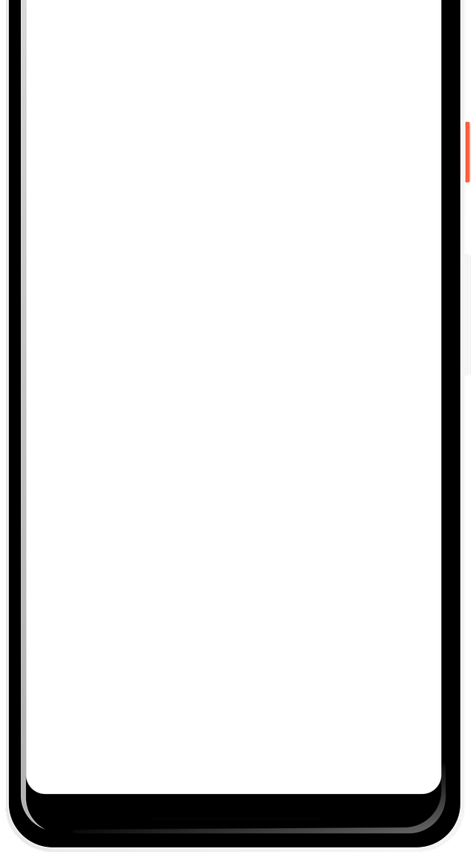

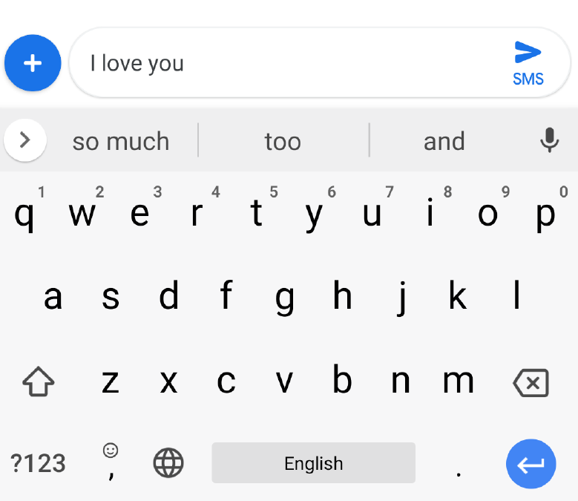
Background
Federated Learning (FL)
Machine learning is pervasive but data-hungry.
Collaborative machine learning has been demonstrated effective on lightweight devices like smartphones.
Federated learning (FL) is a collaborative learning paradigm designed to preserve participating clients’ data.
Google’s Gboard is a representative application of federated learning on Android devices.
Gboard (Google’s input method on Android devices) has adopted federated learning technique in predicting users’ keyboard input.
Notes:
Along with the raise of smartphone, machine learning, or more precisely deep machine learning, brings another wave of technical progress during the last decade.
[READ]

Slide 45
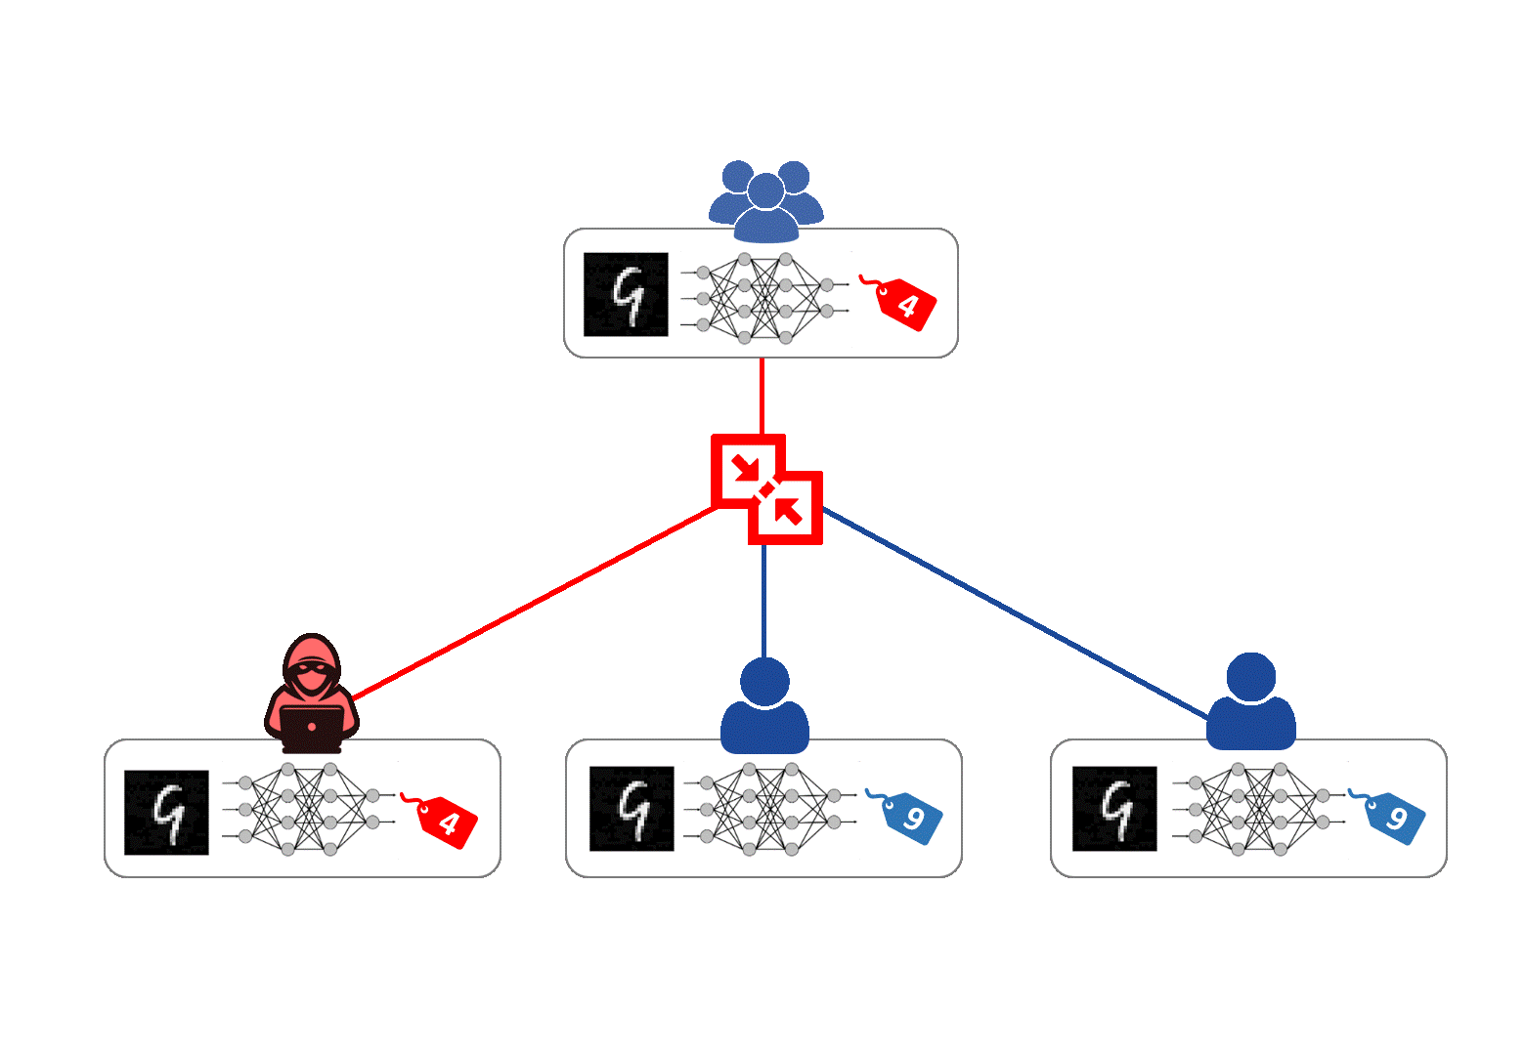
Background
Attacking Federated Learning
FL is prone to be manipulated by malicious clients.
Malicious clients can deploy the poisoning attack.
Untargeted attacks
Aims to reduce the overall learning accuracy.
(Comparably) easier to defend.
Targeted attack
Aims to precisely misclassify.
By label-flipping or backdoor.
Notes:
Unfortunately, same as centralized machine learning, FL is prone to be manipulated by malicious clients.
The Byzantine failure is a major threat to FL due to its distributed paradigm [paradaim], where malicious clients can deploy the "poisoning attack".
According to the existing literature, we can summarize the poisoning attack into two types, namely untargeted attacks, and targeted attacks.
Untargeted attacks aim to reduce the overall learning accuracy, and it is known to be (comparably) easier to defend.
The latter, targeted attacks, aim to precisely misclassify. It is generally achieved by label-flipping or embedding a backdoor pattern into the training set.

Slide 46
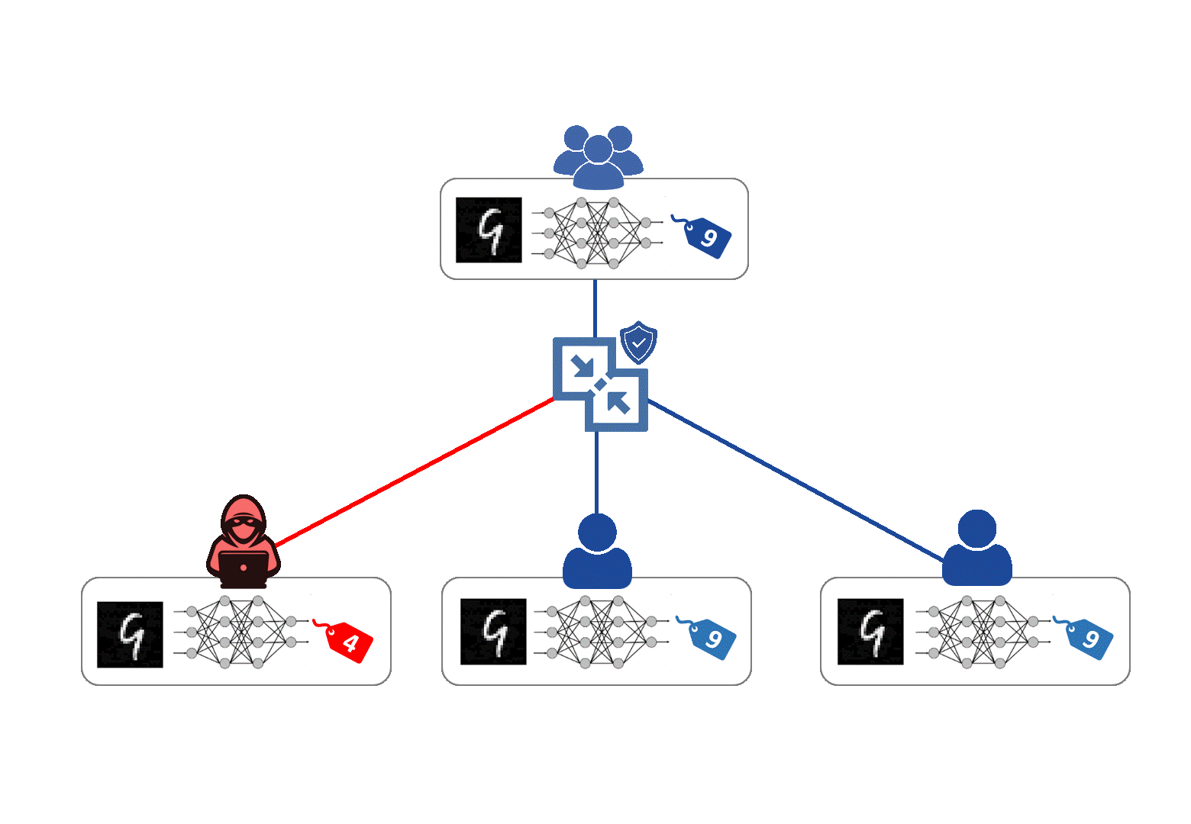
Related Work
Byzantine-resilient aggregations against poisoning attacks (aka. AGRs)
Median, Trimmed-mean (Yin et al., 2018)
Krum, Multi-Krum, Bulyan (Blanchard et al., 2017, El Mhamdi et al., 2018)
Auxiliary (but effective) defenses
Pre-aggregation or Post-aggregation
ERR, LFR, and ERR+LFR (aka. Fang’s defense) (Fang et al., 2020)
Trust bootstrapping (Cao et al., 2021)
Post-training pruning & fine-tuning (Wu et al., 2022)
Notes:
Given the threat of Byzantine failure, how to achieve Byzantine-resilient FL becomes an open question in the research community.
There are dozens of publications on this topic during the past few years, and we find most existing research address the Byzantine failure challenge through the lens of Byzantine-resilient aggregations, or shortly we call them “Robust Aggregations” or “AGRs”.
Existing robust aggregations include widely used Median and Trimmed-mean. More advanced AGRs also include Krum, Multi-Krum, and Bulyan.
Besides robust aggregations, there also exists some Auxiliary (but effective) defenses, which are either designed to take place in the Pre-aggregation stage or Post-aggregation stage.
On this slide, I just show some typical defenses in different streams, and these approaches are known as state-of-the-art in recent research.

Slide 47
Motivations & Goal
Byzantine-resilient aggregations
Tend to over-rely on the estimation of the population of malicious clients.
Auxiliary defenses
Request participating clients’ cooperation, or even disclosure of their training set.
Do not work well with each other.
We study the adoption of pruning that ⁽¹⁾ does not rely on the training data and therefore, can be solely performed by the server ⁽²⁾ to boost the robustness-preservation ⁽³⁾ without (explicitly) asking for clients’ cooperation.
Notes:
From the literature, we find existing defense approaches, more or less, have limitations in practice, which we aim to address in this paper.
As a result, we propose a pruning technique for FL and name our solution FLAP.
For Byzantine resilient aggregations, they tend to over-rely on the estimation of the number of malicious clients, which is the most critical limitation because nobody can precisely know which clients are malicious in a dynamic, distributed and adversarial scenario. For that reason, FLAP is designed as an auxiliary defense that can be a great relief.
FLAP also aims to address the compatibility issue of existing auxiliary approaches. In other words, most existing auxiliary defense techniques more or less modify the generic FL process and therefore, cannot work with each other into one FL application.
Moreover, as we adopt data-free pruning, our FLAP do not request participating clients' cooperation, and do not ask them to disclose any part of their training dataset.

Slide 48
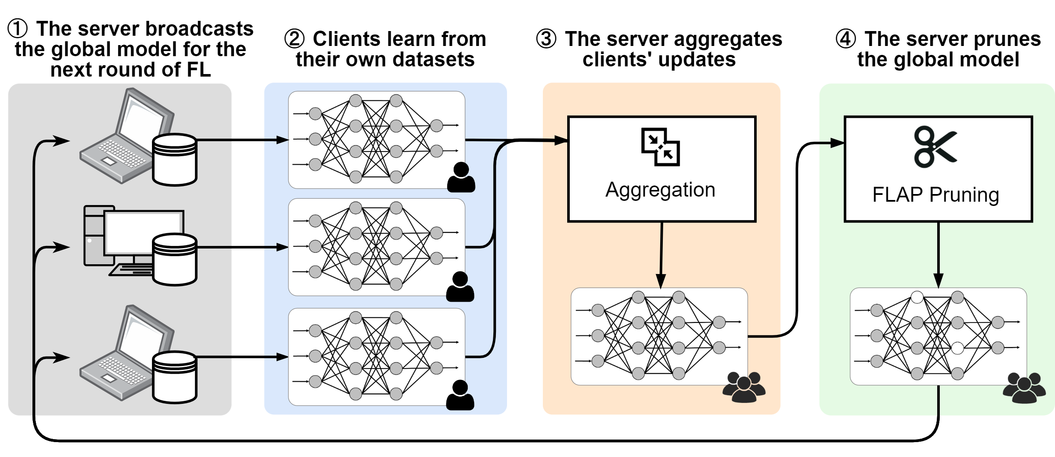
Our Solution - FLAP
Approach Overview
FLAP is motivated by an insight that model pruning could disable the insignificant and dormant parameters.
The biggest challenge of the design of FLAP is how to achieve fidelity and robustness-preserving model pruning without the client’s training data.
The workflow of federated learning with FLAP
Notes:
FLAP is motivated by an insight that model pruning could disable the insignificant and dormant parameters, and by doing this, enhance the robustness against Byzantine attack.
The figure on this slide shows an approach overview of FLAP.
As you can see, the first 3 steps are exactly the generic FL process. What we have done for FLAP is step 4, right after the server comes up with the aggregated model by using WHATEVER aggregation algorithm.
Then, FLAP performs pruning over the newly aggregated model and takes the pruned model as the global model for the next round of training.
By doing this, FLAP can natively work with any existing defense technique, including both robust aggregation and auxiliary defenses, as long as they follow the basic FL paradigm.

Slide 49
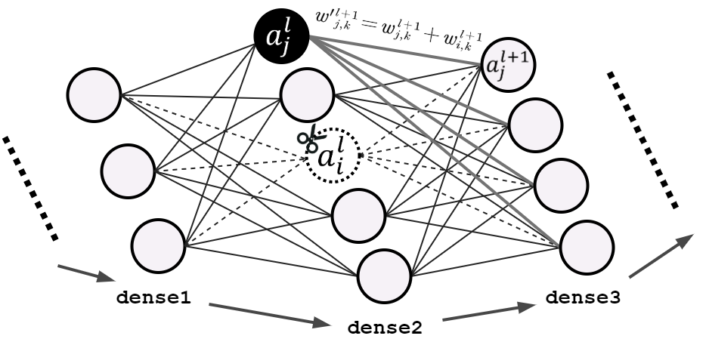
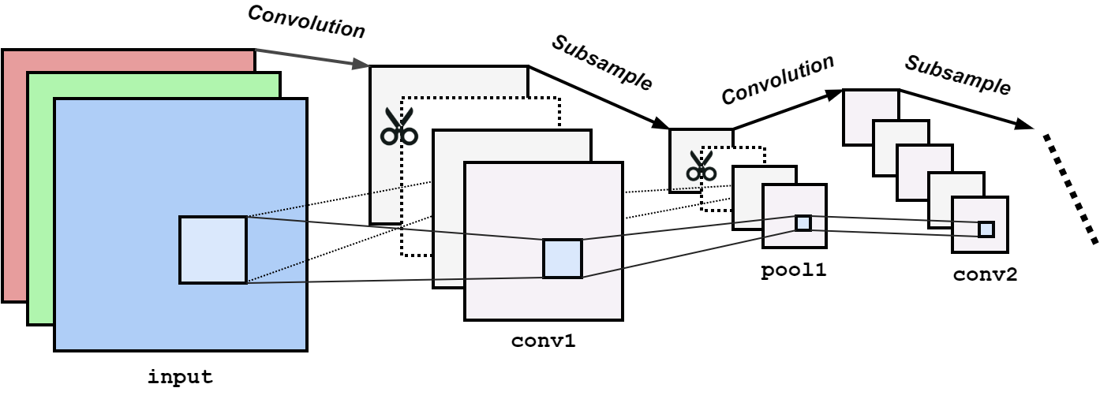
Our Solution - FLAP
Data-free Pruning
The design of FLAP adopts the existing data-free pruning techniques (Srinivas & Babu, 2015, Meng et al., 2023) to prune hidden units in dense layers.
Pair-wise pruning (cut one and keep the other).
Cross-layer saliency-based sampling.
Zero out the pruned parameter.
FLAP also performs a scale-based sampling strategy for convolutional layers.
Prioritize the least salient channels for pruning.
Measure the scale of a channel via L1-norm.
Notes:
For the pruning process, we designed different pruning approach for different types of layers.
For dense layers, we adopt pair-wise pruning, which means we always choose hidden units in pairs, cut one, and keep the other. We use cross-layer saliency-based sampling to locate the hidden units to be pruned. As the pruned model needs to be used for continuous training, our pruning does not really cut the hidden units, but zero out the hidden units' parameters instead.
On the other hand, for the convolutional layers, FLAP uses a very straightforward scaled-based sampling strategy to zero out the least salient channels according to their L1-norm, as shown in the figures on this slide.

Slide 50
Evaluation
An Overview
Our evaluation aims to address two research questions:
RQ1: What is the effectiveness of the proposed FLAP? Does it preserve the model fidelity in benign settings? Does it impair the learning process?
RQ2: What is the performance of FLAP in adversarial settings? Does FLAP outperform existing defenses? Can FLAP boost existing defensive techniques towards Byzantine-robust FL?

Slide 51
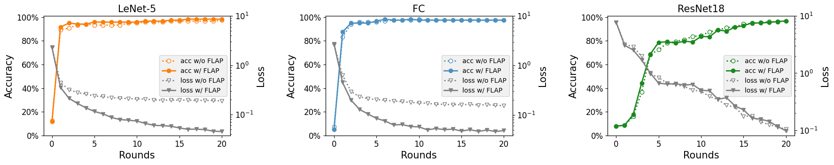
Evaluation
RQ1: Effectiveness of FLAP in benign settings
RQ1 aims to investigate if FLAP suits the FL as a post-aggregational defensive optimization.
Three models (LeNet-5, MLP, and ResNet-18 models), trained with FEMNIST dataset
Observations
The growth of test accuracy of models with FLAP is almost identical with the models without it.
Findings
FLAP shows promising fidelity preservation in a non-adversarial circumstance.
FLAP does not impair the learning process.
Test accuracy and loss of FL up to round 20, with and without FLAP
Notes:
Our evaluation of FLAP begins with investigating whether FLAP is effective in benign settings.
We test FLAP on three models and compare the training process with the FL without FLAP. Our observations show that the growth of test accuracy of models with FLAP is almost identical to the models without it ... [READ THE SLIDE]
As a result, FLAP shows promising fidelity preservation in a non-adversarial setting, and it DOES NOT impair the learning process.

Slide 52
Evaluation
RQ2: FLAP in adversarial settings
RQ2 aims to study if FLAP can boost the existing defensive techniques towards Byzantine-robust FL.
Experiment Setup
We use three modes (conservative, perfect, and radical) to simulate when the server under-estimates, exactly estimates, and over-estimates the presence of adversarial clients.
We calculate the average error rate (for robustness evaluation) and test accuracy for 10 rounds.
We reflect the change (annotated with growth ▲, unchanged ◆ and decay ▼) in the table (in the next two slides).
Notes:
After we guarantee that FLAP won't impair the benign FL, our next research question aims to study if FLAP can boost... [READ THE SLIDE]
We use 3 experimental settings to configure existing robust aggregations, to simulate when the server under-estimates, exactly estimates or over-estimates the number of malicious clients.
Since we perform our experiments in an adversarial setting, we record both the accuracy and error rate to evaluate the model robustness.

Slide 53
Evaluation
RQ2.1: FLAP in adversarial settings (vs. Byzantine-resilient aggregations)
Observations
Existing Byzantine-resilient aggregations help reduce the error rate and improve the test accuracy only when the server sufficiently estimates the presence of malicious clients (i.e., perfect and radical modes).
The adoption of FLAP is independent of the server’s knowledge about the attackers’ population.
Findings
FLAP can improve the FL in all three modes of the two aggregation algorithms.
FLAP reduces error rate by up to 12.5%.
FLAP helps FL to better converge with an improvement in average test accuracy of 21.5%.
Average error rates and test accuracy of FL (ResNet-18) equipped with different robust-aggregation rules, with (bold) and without FLAP
Aggregation Rules (in diff. configurations) |  | Error Rate (Lower is Better) | Test Accuracy (Higher is Better)
FedAvg |  | 30.8%, 20.0% (-10.8%▼) | 10.3%, 10.9% (0.6%▲)
Trimmed Mean | Conserv. | 87.0%, 74.0% (-12.3%▼) | 11.5%, 14.6% (3.1%▲)
 | Perfect | 30.0%, 17.5% (-12.5%▼) | 92.1%, 97.8% (5.7%▲)
 | Radical | 11.4%, 9.8% (-1.6%▼) | 94.6%, 95.1% (0.5%▲)
Multi- Krum | Conserv. | 84.3%, 83.7% (-0.6%▼) | 34.5%, 56.0% (21.5%▲)
 | Perfect | 35.6%, 43.5% (-2.7%▼) | 35.6%, 43.5% (7.9%▲)
 | Radical | 28.8%, 27.3% (-1.5%▼) | 35.3%, 44.2% (8.9%▲)
Notes:
To answer this research question, we conduct two sets of experiments. Our first set of experiments focus on comparing FLAP with SoTA Byzantine-resilient aggregations.
Given the experimental outcome, we observed that the existing Byzantine-resilient aggregations work well, but only when the server has sufficiently estimated the number of malicious clients, which corresponds to the perfect and radical modes in the table.
However, we remark that knowing how many malicious clients are there, is absolutely difficult in real-life scenarios.
[CLICK]
But for FLAP, we find its adoption is independent of the server's knowledge about the attacker population.

Slide 54
Evaluation
RQ2.1: FLAP in adversarial settings (vs. Byzantine-resilient aggregations)
Findings
FLAP can improve the FL in all three modes of the two aggregation algorithms.
FLAP reduces error rate by up to 12.5%.
FLAP helps FL to better converge with an improvement in average test accuracy of 21.5%.
Average error rates and test accuracy of FL (ResNet-18) equipped with different robust-aggregation rules, with (bold) and without FLAP
Aggregation Rules (in diff. configurations) |  | Error Rate (Lower is Better) | Test Accuracy (Higher is Better)
FedAvg |  | 30.8%, 20.0% (-10.8%▼) | 10.3%, 10.9% (0.6%▲)
Trimmed Mean | Conserv. | 87.0%, 74.0% (-12.3%▼) | 11.5%, 14.6% (3.1%▲)
 | Perfect | 30.0%, 17.5% (-12.5%▼) | 92.1%, 97.8% (5.7%▲)
 | Radical | 11.4%, 9.8% (-1.6%▼) | 94.6%, 95.1% (0.5%▲)
Multi- Krum | Conserv. | 84.3%, 83.7% (-0.6%▼) | 34.5%, 56.0% (21.5%▲)
 | Perfect | 35.6%, 43.5% (-2.7%▼) | 35.6%, 43.5% (7.9%▲)
 | Radical | 28.8%, 27.3% (-1.5%▼) | 35.3%, 44.2% (8.9%▲)
Notes:
[FOLLOW THE PREVIOUS SLIDE]
So our conclusion of this set of experiments is that, we find FLAP can improve the FL in all 3 configurations of the two aggregations, bringing 2 digit reduction in error rate and test accuracy improvement.

Slide 55
Evaluation
RQ2.2: FLAP in adversarial settings (vs. advanced adversarial/defensive models)
Benchmarking
FLAP does not aim to replace existing defense but to co-exist and boost them.
We carry out benchmarking by observing robustness-preservation with and without FLAP.
Defensive effectiveness:
FLAP only
ERR+LFR (a.k.a. Fang’s defense) only
FLAP together with ERR+LFR (Fang’s defense)
Adversarial models:
Partial knowledge attack (Fang et al., 2020)
Full knowledge attack (Fang et al., 2020)
Notes:
Our last set of experiments compares FLAP with the latest adversarial and defensive models.
Again, we highlight that FLAP does not aim to replace the existing defense but to co-exist with them and boost the robustness preservation.
Thus, we carry out benchmarking from FL with and without FLAP.
Our benchmarking objects, include the ERR+LFR defense, also known as Fang's defense; and partial and full knowledge attack, which refer to Fang's attack in some literature.

Slide 56
Evaluation
Changes in average error rates and test accuracy of FL (ResNet-18) in various adversarial and defensive settings, after the adoption of FLAP
RQ2.2: FLAP in adversarial settings (vs. advanced adversarial/defensive models)
Aggregation Rules | Auxiliary Defense | Adversarial Models
 |  | Targeted Label Flipping | Partial Knowledge | Full Knowledge
Error Rates (Lower is Better)
FedAvg | –– | -10.8%▼ | -42.8%▼ | -20.0%▼
Trimmed Mean (Conserv.) | –– | -12.3%▼ | -9.6%▼ | -31.8%▼
 | ERR+LFR | -39.2%▼ | -8.7%▼ | -16.3%▼
Trimmed Mean (Perfect) | –– | -12.5%▼ | -5.4%▼ | -5.1%▼
 | ERR+LFR | -1.2%▼ | -1.3%▼ | -6.4%▼
Trimmed Mean (Radical) | –– | -1.6%▼ | -1.7%▼ | -2.1%▼
 | ERR+LFR | 0.0%◆ | -1.6%▼ | -0.3%▼
Multi-Krum (Conserv.) | –– | -0.6%▼ | -18.5%▼ | -9.6%▼
 | ERR+LFR | -0.8%▼ | -10.9%▼ | -8.1%▼
Multi-Krum (Perfect) | –– | -2.7%▼ | -7.1%▼ | -6.4%▼
 | ERR+LFR | -2.7%▼ | -6.4%▼ | -6.4%▼
Multi-Krum (Radical) | –– | -1.5%▼ | -9.4%▼ | -2.3%▼
 | ERR+LFR | -6.4%▼ | -6.9%▼ | -10.2%▼
Test Accuracy (Higher is Better)
FedAvg | –– | 0.6%▲ | 0.0%◆ | 0.2%▲
Trimmed Mean (Conserv.) | –– | 3.1%▲ | 3.8%▲ | 2.6%▲
 | ERR+LFR | -0.2%▼ | 5.2%▲ | 1.3%▲
Trimmed Mean (Perfect) | –– | 5.7%▲ | 0.9%▲ | 2.6%▲
 | ERR+LFR | -0.4%▼ | 0.5%▲ | -0.2%▼
Trimmed Mean (Radical) | –– | 0.5%▲ | 0.9%▲ | -0.4%▼
 | ERR+LFR | 0.2%▲ | 0.3%▲ | 0.0%◆
Multi-Krum (Conserv.) | –– | 21.5%▲ | 20.8%▲ | 14.6%▲
 | ERR+LFR | 21.6%▲ | 21.7%▲ | 22.1%▲
Multi-Krum (Perfect) | –– | 7.9%▲ | 8.7%▲ | 8.7%▲
 | ERR+LFR | 7.9%▲ | 8.7%▲ | 10.4%▲
Multi-Krum (Radical) | –– | 8.9%▲ | 9.9%▲ | 11.3%▲
 | ERR+LFR | 8.9%▲ | 12.4%▲ | 11.5%▲
Observations
FLAP brings a higher accuracy and lower error rate in the vast majority of adversarial settings.
Findings
FLAP is shown effective towards Byzantine-robust FL in both benign and adversarial environments.
It can boost existing defenses for a higher degree of Byzantine-robustness.
Notes:
So I would like to skip describing our data and directly present our findings in this experiment.
We find FLAP is effective towards Byzantine-robust FL in both benign and adversarial environments, and it CAN boost the existing defense towards a higher degree of Byzantine-robustness.

Slide 57
Contributions
FLAP: a novel FL pruning technique for enhancing robustness w/o sharing clients’ data
Without relying on an estimation of malicious clients’ population
Makes no request for the cooperation of participating clients
FLAP is a defensive technique that can coexist with off-the-shelf approaches and boost their robustness preservation.
Notes:
Now it’s time to wrap up.
In this paper, we propose FLAP, a novel FL pruning technique for enhancing robustness. It gets rid of the limitation of existing defenses.
We also perform an empirical study to explore the effectiveness of FLAP in an adversarial environment.
Last but not least, we conduct a comparative benchmarking with the SoTA defense techniques and show FLAP can outperform them and boost them towards a higher degree of Byzantine-robustness.

Slide 58
Future Research Directions
Exploring the latest causal LLMs in privacy policy analysis
Latest causal LLMs (e.g., Llama, GPT) are more powerful in natural language comprehension.
Finding the optimal threshold may no longer needed and can be replaced by prompt engineering.
Improvement of the static analysis
Complement with dynamic analysis to minimize false positives
Improvement of the data-agnostic pruning
Extend the pruning method to more types of ML models
Explore more use cases in trustworthy AI/ML areas
Notes:
Now it’s time to wrap up.
In this paper, we propose FLAP, a novel FL pruning technique for enhancing robustness. It gets rid of the limitation of existing defenses.
We also perform an empirical study to explore the effectiveness of FLAP in an adversarial environment.
Last but not least, we conduct a comparative benchmarking with the SoTA defense techniques and show FLAP can outperform them and boost them towards a higher degree of Byzantine-robustness.

Slide 59
Conclusion
This thesis includes three research works:
We investigated whether the operating systems (OSes) themselves comprehensively safeguard users’ personal data
We performed a large-scale measurement of the third-party SDKs’ privacy preservation and their compliance of the ever-strengthening privacy protection regulations
We designed a practical data-free optimization approach toward privacy-preserving Byzantine-resilient federated learning for lightweight devices
OS-level
SDK-level
ML app level

Slide 60



Thank You & Acknowledgements
Thesis examiners
Assoc Prof Chang Ee-chien,
Assoc Prof Liang Zhenkai,
and all faculties, staff, friends, and collaborators that I have worked with.
Prof. Dong Jin Song
Assoc. Prof. Bai Guangdong
Dr. Teo Sin Gee
I am grateful for having all of you during this journey!
Notes:
So that’s all of my presentation, thanks for your time and thanks for listening.
I am happy to answer your questions.

Slide 61
Thank You and Q&A

Slide 62
Privacy Preservation in the Android Ecosystem
PhD Oral Examination
26 June 2024
Mark Huasong MENG
National University of Singapore
Supervisor
Professor Dong Jin Song
Chair
Associate Professor Roland Yap Hock Chuan
Examiners
Associate Professor Chang Ee Chien
Associate Professor Liang Zhenkai

Slide 63
Assessing Documented Channels
U2-I2 aims to test two types of errors:
Legacy permissions
e.g., additional permissions requested, or higher permissions introduced
Missing de-identification
e.g., MAC address randomization
Notes:
Because we have already recognized 6 pre-identified UUIs, our approach starts with documented channel assessment.
At this step, U2I2 tests the UUI access on behalf of a third-party application.
We aim to test 2 types of errors, namely legacy permissions and missing de-identification, for example the MAC address randomization in Android.

Slide 64
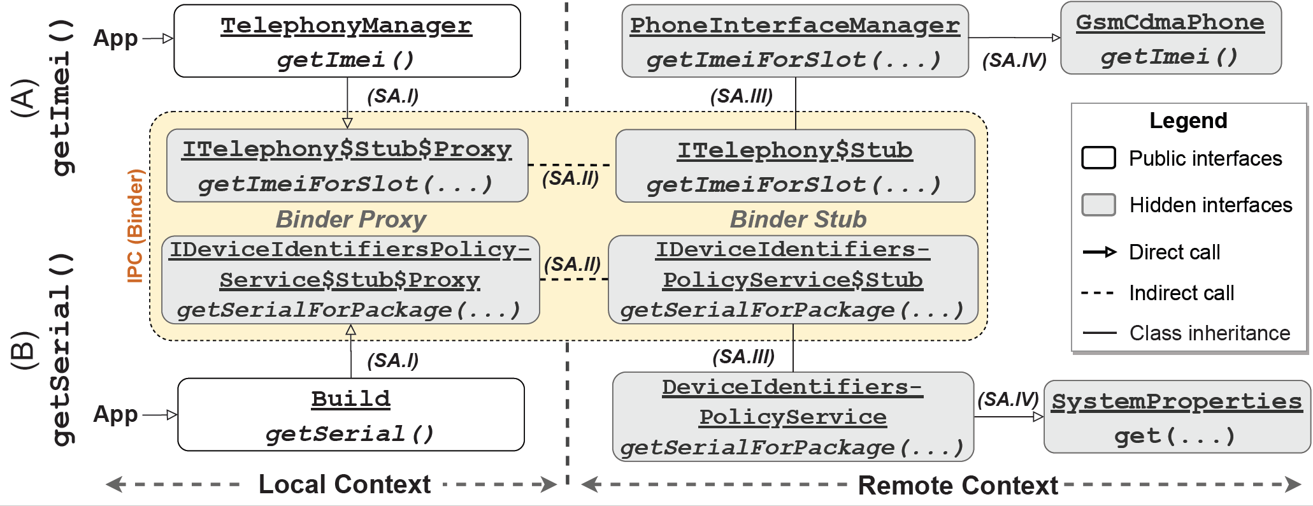
Assessing Undocumented Channels
Two Typical Static Control Flows of the API Invocation
Notes:
This slide demonstrates two typical static control flow of the API invocation.
The first API is getImei() and the second one is getSerial().
Through the control flow we can see the invocation of API to access pre-identified UUIs shares a similar pattern.
They are usually handled by a system service, as shown in the yellow box on the screen.
The dashed line connecting the local context and remote context represents an inter-process communication, which is realized by the Android binding mechanism. So, after the corresponding system service received the request, the control flow continues until the endpoint that the UUI is to be served by the OS.
[CLICK FOR THE NEXT SLIDE]
Okay, what we learned from this control flow? First of all, we find that the invocation of API to access a UUI is usually handled by system services.
This inspires us to explore an access channel to directly invoke the public interfaces defined in system services.
We also find another access channel, called system properties, that appears in the green color box, as we find they are the actual provider of the serial number at the end of the control flow.

Slide 65
Assessing Undocumented Channels
The invocation of API to access a UUI is usually handled by a system service of Android.
Two Typical Static Control Flows of the API Invocation
Visualization of two typical control flows starting from documented APIs. (System properties and system services)
Notes:
…
The invocation of API to access a UUI is usually handled by a system service of Android
This inspires us to explore an access channel to directly invoke the public interfaces defined in system services.
[CLICK]

Slide 66
Assessing Undocumented Channels
The invocation of API to access a UUI is usually handled by a system service of Android.
Two Typical Static Control Flows of the API Invocation
Visualization of two typical control flows starting from documented APIs. (System properties and system services)
System properties are the actual component to serve the serial number.
Notes:
…
We also find another access channel, called system properties, appears in the green color box, as we find they are the actual provider of the serial number at the end of control flow.

Slide 67
Key Finding 1 (Additional)
Landscape of OS-level UUI Safeguards – Misc. UUIs
14 unique miscellaneous UUIs recognized from 18 occurrences.
Recognized miscellaneous UUIs covers identifiers of NFC module, display panel, PCB, camera, and fingerprint sensors.
Channel | Name | Format & Purpose (keywords display in Bold format)
System Settings | Global.cplc (C₁₀) | 45-byte hex string, for NFC module
 | Global.ro.boot.oled_wp (H₁₁) | 8-byte hex string, for OLED display panel
 | System.ReaperAssignedDeviceId (B₉) | 30-digit decimal string, unknown type⁺
System Properties | gsm.serial (C_{10,11}, D_{10,11}) | 19-digit decimal string, the device PCB serial number
 | ro.ril.oem.sno (H_{10,11}) | 8-byte hex string, unknown type⁺
 | vendor.camera.sensor.frontMain.fuseID (H₁₀) | 64-byte alphanumeric string, ID of the front main camera
 | vendor.camera.sensor.rearMain.fuseID (H₁₀) | 64-byte alphanumeric string, ID of the rear main camera
 | vendor.camera.sensor.rearUltra.fuseID (H₁₀) | 64-byte alphanumeric string, ID of the rear ultra-wide camera
 | vendor.camera.sensor.rearTele.fuseID (H₁₀) | 64-byte alphanumeric string, ID of the rear telephoto camera
 | persist.vendor.sys.fp.info (H₁₀) | 8-digit hex string, fingerprint sensor related
 | persist.vendor.sys.fp.uid (H₁₀) | 14-digit hex string, fingerprint sensor related
 | ro.qchip.serialno (F₁₀) | 8-digit hex string, a serial number of an embedded chip module
 | ro.recovery_id (B₉) | 32-digit hex string, ID of the boot image
 | ro.expect.recovery_id (B₉) | 32-digit hex string, a same value as above
+ The UUIs labelled as “unknown type” contain insufficient information in their names and values.
Notes:
For the miscellenous UUIs, we find 14 unique UUIs from 18 occurrences.
The recognized miscellenous UUIs covers identifiers of NFC module, display panel, PCE, camera and fingerprint sensors.
[JUST READ]

Slide 68
Background
Third-Party SDKs
A software development kit (SDK) is a set of platform-specific building tools for developers*.
Third-party SDKs offers app developers a broad spectrum of functionalities
User authentication
UI enhancement
Advertising/analytics, etc.
Android ecosystem provides an easy way to integrate SDKs in apps
A third-party app embeds 8-9 SDKs in average⁺.
* Definition cited from Amazon AWS developer documentation.
+ Statistical results of the top 300 apps from Google Play App Store and the top 300 apps from Xiaomi App Store.
Notes:
First of all, what are third-party SDKs?
SDK stands for software development kit, which is a set of platform-specific building tools for developers. [READ]

Slide 69



Our Approach
Collecting SDKs
Collect third-party SDKs from two mainstream release platforms
Two repositories identified
Google Play SDK Index
CAICT – An alternative source
158 SDKs with their latest release collected
139 are from Google Play SDK Index and 19 are from CAICT
JAR/AAR package files
Meta-information and privacy policies/developer disclosures
JAR
AAR
Notes:
For the SDK collection, we retrieve as many third-party SDKs as possible.
[READ]

Slide 70
Document Analysis
Collecting Meta-Information and Privacy Policies
We implement a Python crawler by Selenium
Meta information Crawling
SDK name
Provider (developer’s identity)
Maven IDs
Functional Category
Privacy Polices
Linked webpages are crawled*
Only 52 SDKs’ privacy policies are provided on their product pages
109 SDK privacy policies are collected after manual search
* indexed by data safety section guidance (Google Play SDK Index) and privacy policy (CAICT)
Notes:
For the second stream, we analyze privacy policies that are written by unstructured natural languages.
To this end, we first collect privacy policies as well as all relevant information, here we name it META-INFORMATION, for each collected SDK.
A python crawler is implemented to retrieve those information from the two release platforms’ website.
As a result, we collected SDK name, its provider’s ID, Maven ID, and its functional category, to complement the privacy policy documents.
For the privacy policies, we crawl the linked webpage indexed by data safety section guidance on Google Play SDK index, and the linked webpage by privacy policy on CAICT website.
As mentioned before, the SDK markets do not have a strict and comprehensive regulation like app stores. We find that not all SDKs come with a privacy policy or equivalent document.
In the end, we only manage to collect privacy policies of 52 SDKs.

Slide 71
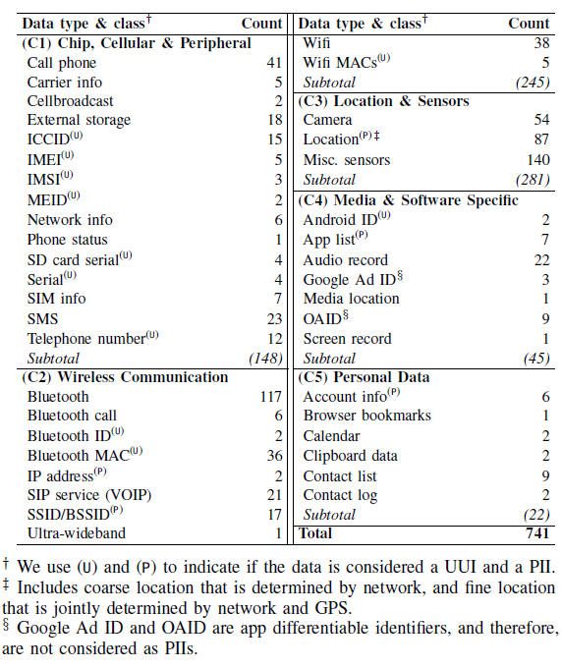
Static Analysis
Configuring Taint Analysis
We resort to static taint analysis* to identify “What do SDKs collect?”
We recognize APIs that collect the previously identified privacy data as source methods and identify the APIs that could save or share those privacy data into public spaces as sink methods.
741 source methods are selected to cover the 41 identified privacy data
* We resort to the latest open-sourced taint analysis toolkit for Android apps named “AppShark” to perform our analysis.
Notes:
This slide shows the 41 types of privacy data organized into 5 classes.
With those data types identified, we move our steps to taint analysis, which aims to help us understand “what types of privacy data that SDKs collect”.
Static taint analysis is a common software engineering technique.
By specifying a source method and sink method, Taint analysis, aims to identify all possible code traces connecting the source and sink methods in sequence.
[READ STARTING FROM THE 2nd PARAGRAPH]

Slide 72
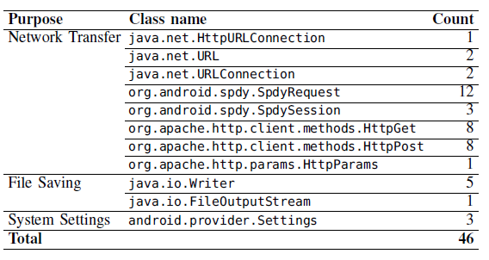
Static Analysis
Configuring Taint Analysis
46 methods are identified as the sink methods, with their functionalities covering network transfer, file saving, and writing into the system settings.
All the sinks are considered public locations that an arbitrary third-party app can access*.
* We remark that some access actions may need a non-dangerous permission (e.g., access Internet, read public directories, etc)
Notes:
After identifying source methods, next we are going to identify sink methods.
In this work, there are 46 sink methods identified, with their functionality covering network transfer, file saving to the local public directories, and the system settings that store system-level preference and configuration.
Here I’d like to remark that, all sinks are considered public locations that an arbitrary third-party app can access.
Which means, we don’t consider the places that only privileged system apps can access, for example, the process file system, and apps’ own directories.

Slide 73
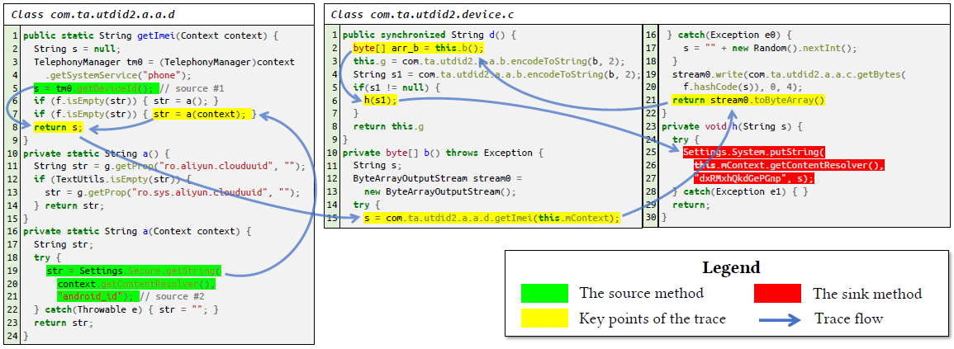
System Settings Injection Issues
An Example
System settings injection issues can be exploited by malicious SDKs when it is embedded in a pre-installed app or system app.
It alters the temporal validity and visibility of an app-specific resettable ID to a de facto UUI.
Successful exploitation can bypass the privacy mechanism of Android OS and share a UUI in the public space.
Notes:
[READ]
Ok, to put it simple. This issue can be manipulated by a “Lucky” SDK if it is embedded into a pre-installed app. Then it can write anything into the system settings, which doesn’t have to be a real hardware ID, or any actual user privacy data like birthday, email address, and so on.
It only need to randomly produce a unique string, which can differentiate the current device from another, that string becomes a de factor unique identifiable data and can be accessed by an arbitrary third-party app.
So as long as a third-party app knows the key of such a system settings item, it obtains a unique unresettable identifier.
The Android operating system, unfortunately, does not know what happens during the entire procedure.

Slide 74
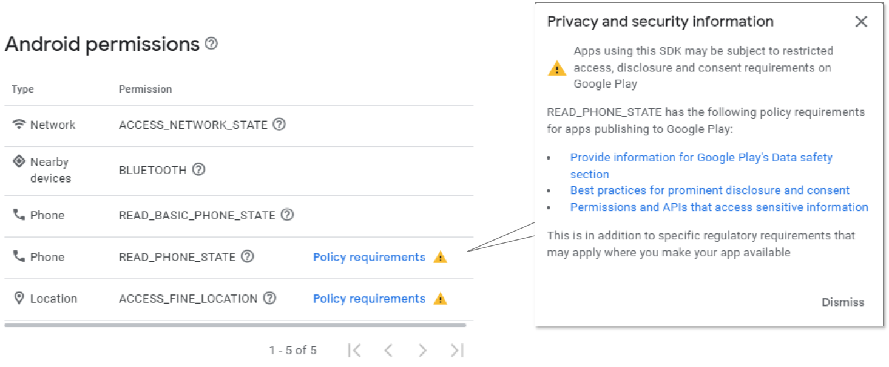
Discussion
Causes of privacy mishandling
Privilege free-riding (System Settings Injection)
Insufficient regulations
Our Recommendations
Precautions of privilege abuse
Strengthened platform regulation
Transparent app development
SDKs released on Google Play SDK Index are requested to disclose the permission needed in their implementation. However, there is no platform-level compliance checking mechanism to ensure the permission disclosure is accurate and complete.
Notes:
Before we finish this work, we discussed the causes of the poor privacy preservation, which we summarized into 2 points.
The first one, privilege free-riding, reflected by the system settings injection issues, originates from a design flaw of Android operating system.
Android specially reverses a privilege group for “pre-installed” apps, which essentially aims to facilitate device vendors’ customization. But later was found vulnerable to malicious app, or a benign app embedding malicious SDKs.
And the second point, which is the real root cause but the most challenging one to solve, is insufficient regulations, from both the platform and regulators.
For each two causes, we provide corresponding recommendations. Lastly, we also call for a transparent app development in the Android ecosystem, so that app developers can be more confident to use the diverse third-party SDKs without worrying their privacy compliance.

Slide 75

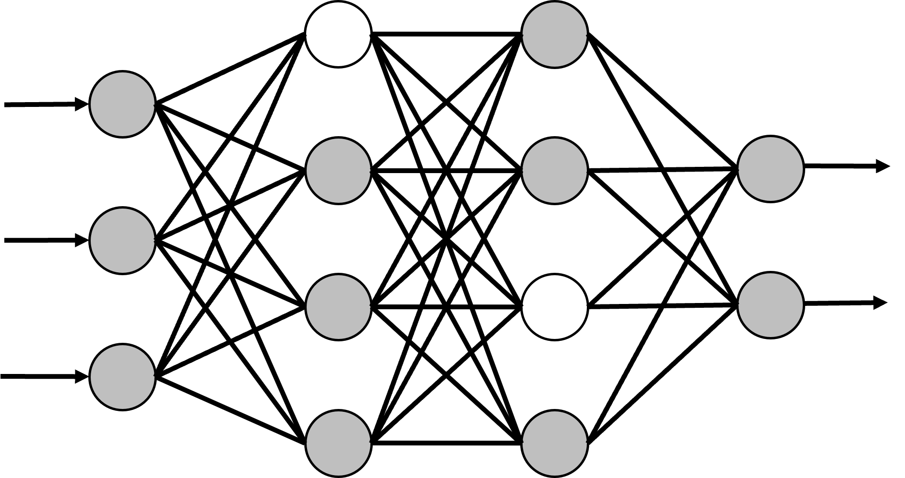
Why Pruning?
When Pruning meets Federated Learning…
Pruning has shown effective in robust-FL in existing research (Wu et al., 2022).
It can remove redundant and “backdoor” neurons that trigger misbehaviors.
It relies on a voting process which requests participating clients’ cooperation.
Data-agnostic pruning is a stream of pruning techniques that does not request dataset access and re-training, and is suitable for the FL paradigm.
Notes:
In this work, we are studying the adoption of neural network model pruning into FL.
The pruning technique has been shown effective in enhancing the robustness of the federated learning model.
The adoption of pruning is shown can remove redundant and “backdoor” neurons that trigger misbehaviors.
However, it comes with a small drawback, as it relies on a voting process that requests participating clients’ cooperation. The rationale of this voting process originates from the conventional pruning process, which may significantly downgrade the model performance and therefore request training data or training feedback, to repair the pruned model.
In that case, data-agnostic pruning is a good choice because it does not request dataset and re-training. In this work, we take advantage of two publications about data-free pruning, and propose a novel data-agnostic pruning that is suitable for the FL paradigm.

Slide 76
Evaluation (Detailed View)
Changes in average error rates and test accuracy of FL (ResNet-18) in various adversarial and defensive settings, after the adoption of FLAP
RQ2.2: FLAP in adversarial settings (vs. advanced adversarial/defensive models)
Aggregation Rules | Auxiliary Defense | Adversarial Models
 |  | Targeted Label Flipping | Partial Knowledge | Full Knowledge
Error Rates (Lower is Better)
FedAvg | –– | -10.8%▼ | -42.8%▼ | -20.0%▼
Trimmed Mean (Conserv.) | –– | -12.3%▼ | -9.6%▼ | -31.8%▼
 | ERR+LFR | -39.2%▼ | -8.7%▼ | -16.3%▼
Trimmed Mean (Perfect) | –– | -12.5%▼ | -5.4%▼ | -5.1%▼
 | ERR+LFR | -1.2%▼ | -1.3%▼ | -6.4%▼
Trimmed Mean (Radical) | –– | -1.6%▼ | -1.7%▼ | -2.1%▼
 | ERR+LFR | 0.0%◆ | -1.6%▼ | -0.3%▼
Multi-Krum (Conserv.) | –– | -0.6%▼ | -18.5%▼ | -9.6%▼
 | ERR+LFR | -0.8%▼ | -10.9%▼ | -8.1%▼
Multi-Krum (Perfect) | –– | -2.7%▼ | -7.1%▼ | -6.4%▼
 | ERR+LFR | -2.7%▼ | -6.4%▼ | -6.4%▼
Multi-Krum (Radical) | –– | -1.5%▼ | -9.4%▼ | -2.3%▼
 | ERR+LFR | -6.4%▼ | -6.9%▼ | -10.2%▼
Test Accuracy (Higher is Better)
FedAvg | –– | 0.6%▲ | 0.0%◆ | 0.2%▲
Trimmed Mean (Conserv.) | –– | 3.1%▲ | 3.8%▲ | 2.6%▲
 | ERR+LFR | -0.2%▼ | 5.2%▲ | 1.3%▲
Trimmed Mean (Perfect) | –– | 5.7%▲ | 0.9%▲ | 2.6%▲
 | ERR+LFR | -0.4%▼ | 0.5%▲ | -0.2%▼
Trimmed Mean (Radical) | –– | 0.5%▲ | 0.9%▲ | -0.4%▼
 | ERR+LFR | 0.2%▲ | 0.3%▲ | 0.0%◆
Multi-Krum (Conserv.) | –– | 21.5%▲ | 20.8%▲ | 14.6%▲
 | ERR+LFR | 21.6%▲ | 21.7%▲ | 22.1%▲
Multi-Krum (Perfect) | –– | 7.9%▲ | 8.7%▲ | 8.7%▲
 | ERR+LFR | 7.9%▲ | 8.7%▲ | 10.4%▲
Multi-Krum (Radical) | –– | 8.9%▲ | 9.9%▲ | 11.3%▲
 | ERR+LFR | 8.9%▲ | 12.4%▲ | 11.5%▲
Observations
FLAP (w/o ERR+LFR, a.k.a. Fang’s defense) can achieve a lower error rate than the ERR+LFR defense (w/o FLAP) in all scenarios of the multi-Krum settings and 2 out of 6 scenarios of the trimmed-mean settings.
It also manages to outperform the ERR+LFR defense in 14 out of 18 scenarios of both aggregation settings w.r.t the test accuracy.
FLAP brings a higher accuracy and lower error rate in the vast majority of adversarial settings.
Findings
FLAP is shown effective towards Byzantine-robust FL in both benign and adversarial environments.
It can boost existing defenses for a higher degree of Byzantine-robustness.
Notes:
So I would like to skip describing our data and directly present our findings in this experiment.
We find FLAP is effective towards Byzantine-robust FL in both benign and adversarial environments, and it CAN boost the existing defense towards a higher degree of Byzantine-robustness.

Slide 77
Selected References of the 1st Work
W. Enck, P. Gilbert, S. Han, V. Tendulkar, B.-G. Chun, L. P. Cox, J. Jung, P. McDaniel, and A. N. Sheth, “Taintdroid: an information- flow tracking system for realtime privacy monitoring on smartphones,” ACM Transactions on Computer Systems (TOCS), vol. 32, no. 2, pp. 1–29, 2014.
L. Qiu, Z. Zhang, Z. Shen, and G. Sun, “Apptrace: Dynamic trace on android devices,” in 2015 IEEE International Conference on Commu- nications (ICC), 2015, pp. 7145–7150.
J. Ren, M. Lindorfer, D. J. Dubois, A. Rao, D. Choffnes, and N. Vallina- Rodriguez, “A longitudinal study of pii leaks across android app versions,” in The Network and Distributed System Security Symposium (NDSS), 2018.
Z. Wang, Z. Li, M. Xue, and G. Tyson, “Exploring the eastern frontier: A first look at mobile app tracking in china,” in International Conference on Passive and Active Network Measurement. Springer, 2020, pp. 314–328.
Selected References of the 2nd Work
B. Andow, S. Y. Mahmud, J. Whitaker, W. Enck, B. Reaves, K. Singh, and S. Egelman, “Actions Speak Louder than Words: Entity-Sensitive Privacy Policy and Data Flow Analysis with PoliCheck,” in USENIX Security, 2020, pp. 985–1002.
W. Enck, P. Gilbert, S. Han, V. Tendulkar, B.-G. Chun, L. P. Cox, J. Jung, P. McDaniel, and A. N. Sheth, “Taintdroid: an information- flow tracking system for realtime privacy monitoring on smartphones,” ACM TOCS, vol. 32, no. 2, pp. 1–29, 2014.
Y. He, B. Hu, and Z. Han, “Dynamic privacy leakage analysis of android third-party libraries,” in ICDIS, 2018, pp. 275–280.
X. Liu, J. Liu, S. Zhu, W. Wang, and X. Zhang, “Privacy Risk Analysis and Mitigation of Analytics Libraries in the Android Ecosystem,” TMC, vol. 19, no. 5, pp. 1184–1199, 2020.
M. H. Meng, Q. Zhang, G. Xia, Y. Zheng, Y. Zhang, G. Bai, Z. Liu, S. G. Teo, and J. S. Dong, “Post-gdpr threat hunting on android phones: dissecting os-level safeguards of user-unresettable identifiers,” in NDSS, 2023.
L. Qiu, Z. Zhang, Z. Shen, and G. Sun, “Apptrace: Dynamic trace on android devices,” in 2015 IEEE ICC, 2015, pp. 7145–7150.
A. Razaghpanah, R. Nithyanand, N. Vallina-Rodriguez, S. Sundaresan, M. Allman, C. Kreibich, and P. Gill, “Apps, Trackers, Privacy, and Regulators: A Global Study of the Mobile Tracking Ecosystem,” in NDSS, 2018.
L. Yu, X. Luo, J. Chen, H. Zhou, T. Zhang, H. Chang, and H. K. N. Leung, “PPChecker: Towards Accessing the Trustworthiness of Android Apps’ Privacy Policies,” TSE, vol. 47, p. 221–242, 2021.
K. Zhang and X. Wang, “Peeping tom in the neighborhood: Keystroke eavesdropping on multi-user systems,” in USENIX Security, 2009.
X. Zhou, S. Demetriou, D. He, M. Naveed, X. Pan, X. Wang, C. A. Gunter, and K. Nahrstedt, “Identity, location, disease and more: Inferring your secrets from android public resources,” in Proceedings of the 2013 ACM SIGSAC CCS, 2013, pp. 1017–1028.
Notes:
Ok, so now I have gone through our first research at the OS-level. This study has been accepted and presented in NDSS 2023.
And on this slide, I also acknowledge some literature that have been mentioned in the previous slides.

Slide 78
Selected References of the 3rd Work
Blanchard, P., Mhamdi, E.M.E., Guerraoui, R., Stainer, J.: Machine learning with adversaries: Byzantine tolerant gradient descent. In: Advances in neural information processing systems (NeurIPS). pp. 119–129 (2017)
Cao, X., Fang, M., Liu, J., Gong, N.Z.: Fltrust: Byzantine-robust federated learning via trust bootstrapping. In: Network and Distributed System Security Symposium (NDSS). The Internet Society (2021)
Chen, X., Liu, C., Li, B., Lu, K., Song, D.: Targeted backdoor attacks on deep learning systems using data poisoning. arXiv preprint arXiv:1712.05526 (2017)
El Mhamdi, E. M., Guerraoui, R., and Rouault, S.： The hidden vulnerability of distributed learning in Byzantium. In: 35th International Conference on Machine Learning (ICML) (2018)
Fang, M., Cao, X., Jia, J., Gong, N.: Local model poisoning attacks to byzantine-robust federated learning. In: 29th USENIX Security Symposium (2020)
Meng, M.H., Bai, G., Teo, S.G., Dong, J.S.: Supervised robustness-preserving data-free neural network pruning. In: International Conference on Engineering of Complex Computer Systems (ICECCS) (2023)
Meng, M.H., Bai, G., Teo, S.G., Hou, Z., Xiao, Y., Lin, Y., Dong, J.S.: Adversarial robustness of deep neural networks: A survey from a formal verification perspective. IEEE Transactions on Dependable and Secure Computing (IEEE TDSC) (2022)
Srinivas, S., Babu, R.V.: Data-free parameter pruning for deep neural networks. In: Proceedings of the British Machine Vision Conference (BMVC) (2015)
Yin, D., Chen, Y., Ramchandran, K., Bartlett, P.L.: Byzantine-robust distributed learning: Towards optimal statistical rates. In: International Conference on Machine Learning (ICML) (2018)
Wu, C., Yang, X., Zhu, S., Mitra, P.: Toward Cleansing Backdoored Neural Networks in Federated Learning. In: IEEE 42nd International Conference on Distributed Computing Systems (ICDCS) (2022)
Notes:
Ok, so now I have gone through our first research at the OS-level. This study has been accepted and presented in NDSS 2023.
And on this slide, I also acknowledge some literature that have been mentioned in the previous slides.

